Slide 1
Lesson 3: The Marketing Mix

Slide 2
Which belongs to which?
Every little helps
I’m lovin’ it
The world’s local bank
Eat fresh
Ideas for life
Taste the rainbow
Think different
Your Vision, Our Future
Connecting People
Tesco
McDonald’s
HSBC
Subway
Panasonic
Skittles
Apple
Olympus
Nokia
Why do businesses use slogans?
Notes:
Reveal the heading first and instruct learners not to shout out as there will be a reward for the team that has the most accurate answers.
Stipulate that no electronic devices can be used on this occasion.

Slide 3
Developing the rationale
A rationale means explaining why a company thought it was necessary to produce a marketing campaign. This includes asking:
Why was the marketing campaign necessary?
What are the marketing objectives of the campaign?
Why is the marketing campaign expected to achieve the marketing objectives?
Apply this to the McDonald’s Monopoly campaign.
Notes:
In order to answer these questions, the marketing department need to use the data from the market research they have undertaken. This will need to be interpreted and analysed and there should be an explanation of how this has been used to make the marketing decisions in the campaign.
Are there any other types of research that need to be undertaken?
Marketing will also need to assess the reliability and validity of the data that has been used to develop the rationale and where the product is in its life cycle.

Slide 4
Product Life Cycle
Businesses may look at this to help make marketing decisions.
Please complete the worksheet
Notes:
In order to answer these questions, the marketing department need to use the data from the market research they have undertaken. This will need to be interpreted and analysed and there should be an explanation of how this has been used to make the marketing decisions in the campaign.
Are there any other types of research that need to be undertaken?
Marketing will also need to assess the reliability and validity of the data that has been used to develop the rationale and where the product is in its life cycle.

Slide 5
The marketing mix (the 4Ps)
Once the marketing department has developed its marketing objectives it can then implement its marketing strategy – commonly referred to as the 4Ps. The 4Ps are product, price, place, promotion.
Product
Need to consider a successful mix of products and services. Researching competitors and customers will help a business develop a successful mix of products (product portfolio).
If a product has a unique selling point (USP) it means there are no other products that have the same features.

Slide 6
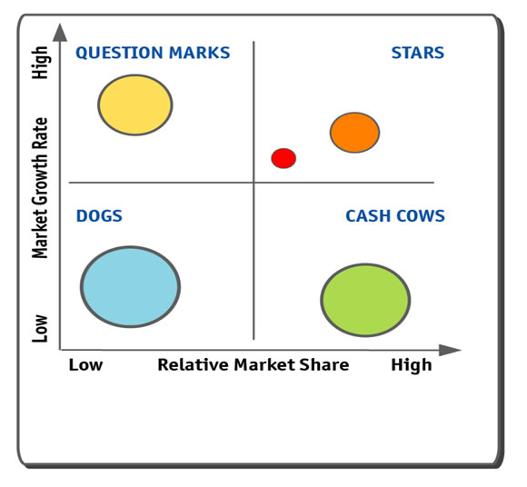
Product Portfolio – Boston Matrix
How many products can you name in each section of the matrix?

Slide 7
The marketing mix (the 4Ps)
Form, function, packaging and branding
Identify at least one example for each of these concepts.
Evaluate the positives of each one.
Propose developments that would provide an enhancement for each of the examples you identified.
Anticipate how your ‘competitors’ will respond by justifying your proposals.
Notes:
Warn learners that they need to be prepared to justify their evaluations and proposals when they present their findings to the rest of the group.
Make learners aware they can use any of the resources available to enhance their presentations: paper for origami packaging, for example.

Slide 8
The marketing mix (the 4Ps)
Price
Prices need to be set for products that meet customers’ and businesses’ expectations. Setting a price too low may attract lots of customers but might not be profitable for the business.
The price should give an indication of the value of the product and can be changed depending on demand.
New innovative products are often given a high price to reflect their USP. Products that are not as different, such as a new packet of crisps, may have a low price to attract customers’ attention as there is so much competition.
Complete the pricing strategy worksheet
Notes:
Pricing strategies include the following.
Penetration pricing: Opposite to price skimming. Used for the launch of a new product. Aim is not to sell to an exclusive segment of the market, but to capture a large share of the market as quickly as possible. Usually used in very competitive markets where there is little product differentiation. Usually supported by other elements of the marketing mix such as promotion to try and establish brand loyalty. If this can be achieved then the price is gradually increased.
Price skimming: Used for the launch of a new product which faces little initial direct competition, e.g. the product has a USP. Launch price is high so the product is bought by a small number of consumers, i.e. early adopters who are not concerned about price. Profit margins are high but usually these are needed to cover the high research costs. The price is then usually lowered as competitors launch competing products or because the business objective is to increase the number of sales.
Competitor pricing: Basing prices on what competitors are charging. Usually used where products are very similar in a market.
Cost plus pricing: Adding the cost of making the product and a percentage mark-up.

Slide 9
The marketing mix (the 4Ps)
Promotion
This is how a business communicates with its customers.
If a product is not communicated effectively, nobody knows about it and therefore it does not make any sales.
advertising
public relations
sponsorship
social media
guerrilla marketing
personal selling
product placement
digital marketing
corporate image
Notes:
Advertising: communicating with customers using TV, newspapers, magazines, billboards, posters, radio and cinema. Used to inform and persuade people to buy. For each advertising campaign, the business needs to decide the message it wants to communicate to customers and the medium it will use. Usually try to promote the uniqueness of the product compared to competitors. Communicates to a large number of customers and not personalised to individuals.
PR: the changing of public opinions through a variety of different communications to customers, e.g. press releases, promotional videos, competitions, prizes, celebrity endorsements, websites, direct mailing and community involvement.
Sponsorship: when a business supports an event by giving money or other resources that are valued by that organisation. In return the business receives advertising at the event and exposure to potential customers.
Social media: the use of social media pages to promote products and events, inviting customers to share events, win prizes and gain immediate feedback from customers.
Guerrilla marketing: low cost unconventional marketing.
Personal selling: verbal communication with customers about a product or service with a view to making a sale. Used to inform customers about products, demonstrate how products work and develop relationships with customers.
Product placement: when businesses pay for their products to be used in films and television programmes.
Digital marketing: the marketing of products on digital media, mainly the internet, smartphones and display advertising.
Corporate image: the way in which a business is seen and perceived by people, i.e. their reputation.

Slide 10
The marketing mix (the 4Ps)
Place
This is where a customer can purchase the product. Most products can nowadays be bought online, through companies’ websites, but not all.
Fish and chip shops are yet to catch onto this trend. However, some have embraced online selling with the use of websites such as Just Eat.

Slide 11
The extended marketing mix (7Ps)
Often businesses also need to consider an additional 3Ps:
Process: These are the inputs that are needed to ensure that the customer has a good experience with the company. For instance, when you check into your hotel, you are greeted, luggage taken to your room and you receive service in the restaurant. This is a marketing process that ensures customers are satisfied with the services provided.
People: Sales people play a part in the marketing of products, from the way they dress (their uniform) to their knowledge about the products. Would you buy a meal in a restaurant if the uniforms of the waiting staff were dirty and they were coughing over the food?
Physical environment: This is the environment where the products are being sold. A well-organised shop often helps to improve customer satisfaction and lead to increased sales. How many times have you walked out of a shop because you cannot find what you are looking for, even though you know it is sold there? Promotions at the ends of aisles or near tills often increase the sales of goods.

