Slide 1
Managing stock
Old web page

Slide 2
Managing stock
This section covers the following:
Why stock management is important
Bar gate stock graphs
Just-in-time stock

Slide 3
Key words
Bar gate stock graph
A diagram to show changes in the level of stock over time
Buffer (stock)
The minimum stock level held at all times to avoid running out
Just In Time (JIT)
Running the business with so little stock that new supplies have to arrive ‘just in time’ before they run out
Stock(s)
Items held by a firm for use or sale, for example components for manufacturing or sellable products for a retailer

Slide 4
Why is stock management important?
Stock(s) are items held by a firm for use or sale.
Without stock, sales could not take place. No sales mean no prospect of profits.
Order too much stock and the business has its cash tied up in items it either cannot sell or has to sell at a lower price.
Order too little stock and the business could miss valuable sales and disappoint customers.

Slide 5
What is product knowledge?
Product knowledge is how well staff know all the features of the products and the service issues surrounding the products.
Good training needs to be given to ensure strong product knowledge. For example, M&S food staff are given trials of new products offered to help inform customers.
Loyal staff that stay with the business mean they gain a huge knowledge of the business and its products. ALDI pay staff above the minimum wage to help retention.
Staff committed to customers helps with product knowledge. Staff at the furniture retailer Sofology are not paid on commission to ensure they are focused on the sofa that meets the customers’ needs.

Slide 6
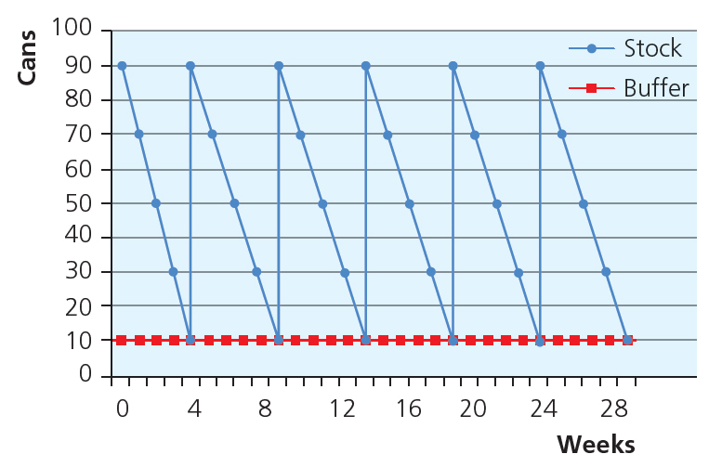
Bar gate stock graphs
The traditional approach to managing stock is shown by the graph.
A bar gate stock graph is a diagram to show changes in the level of stock over time and takes into account three things:
level of demand for the product
buffer stock, which is the minimum stock level held at all times to avoid running out
how often to order from the supplier.

Slide 7
Example bar graph
Bob’s grocery store stocks Heinz Beanz and has regular sales of 20 cans per week.
Bob buys four boxes of beans each time, each containing 20 cans. This way he gets a 10% discount.
He keeps a minimum of 10 cans in stock at all times – his buffer stock.
How often does he buy new stock?
Why does Bob’s stock always peak at 90 cans?
Shops often have computer software that counts sales and automatically places an order at the supplier.

Slide 8
Just In Time (JIT)
What is a disadvantage of Bob having 10 cans as a buffer stock?
Buffer stock has a cost which the business can rarely profit from.
If buffer stock could be got rid of then this space can be used to sell more products and make more profits.
Just In Time (JIT) is running the business with so little stock that new supplies have to arrive ‘just in time’ before they run out.
This way Bob and other businesses can have more space to sell, less money tied up in stock and hopefully be more profitable.

Slide 9
Advantages and disadvantages
Can you name an advantage and a disadvantage of JIT stock management?
See the table for a list.
JIT needs careful consideration by the business before adopting this system.
Businesses need to build a very strong relationship with suppliers to ensure it works consistently.
Advantages | Disadvantages
Eliminating buffer stock cuts storage space, allowing more sales space Low stock and more frequent supplier deliveries mean fresher produce Less of the business’ capital is tied up in stock | A greater risk of running out of stock and therefore disappointing customers Buying smaller quantities more often means losing out on bulk-buying discounts Any mistake or misjudgement could cause out-of-stock and poorer customer service

Slide 10
Summary questions
Write down or discuss the answers to these questions.
What is stock?
What is buffer stock?
Give one drawback of holding buffer stock.
Give one factor a business may need to consider before deciding their stock levels.
What is a bar gate stock graph?
Define Just in time stock management.

