Slide 1
3.2 – Understanding markets and customers: Market analysis

Slide 2
Learning outcomes
Understanding markets and customers
What you need to know:
The interpretation of marketing data
The value of technology in gathering and analysing data for marketing decision-making

Slide 3
Why analyse the market?
Questions to consider:
What aspects of the market will firms need to analyse?
Why is it important for companies to analyse growth in their market?
Consider companies such as:
Cadbury and Nestle
Apple and Sony
Asda and Tesco
Topshop and Marks & Spencer

Slide 4
Why analyse the market?
Aspects of the market which firms need to analyse:
Size of the market – Is it a big enough market? Is it feasible for the firm to operate in?
Growth in the market – Does the market have enough future potential?
Market structure – What level of competition is there? How intense will the competition be?
Segmentation of the market – Who will the company be targeting? What are their needs, wants and tastes?
Social trends – Changing lifestyles, demographics and fashions
What can firms do with this data?

Slide 5
Reasons for analysing the market
Is the product viable?
Identify future trends
Identify opportunities and threats
The firm can then devise new plans and strategies

Slide 6
The interpretation of marketing data
The interpretation of marketing data in this unit will include:
Correlation
Confidence intervals
Extrapolation

Slide 7
1. Correlation
Key term: Correlation - A statistical technique which looks at the strength of the relationship between two variables and how they are related. For example, the relationship between advertising expenditure and sales increases.
Positive correlation
Negative correlation
No correlation
If two variables are correlated they may influence one another.
However, the causal link must be established. Some factors may appear correlated but are not. For example, obesity levels in the UK rising with the level of organic food sales increasing. On a graph they would appear positively correlated but in reality have no impact on one another.

Slide 8
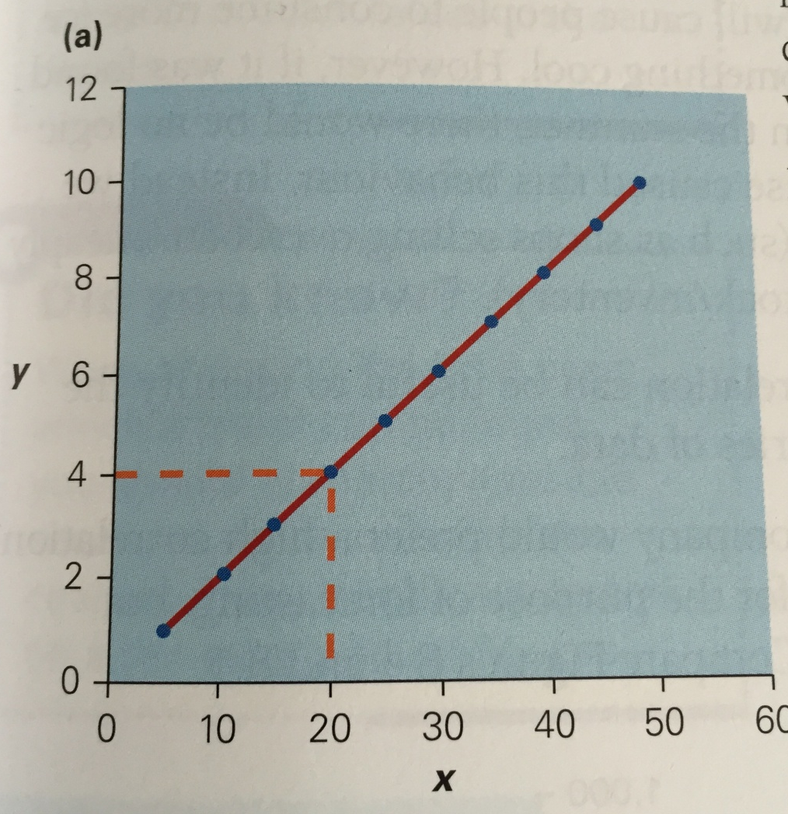
This is a perfect positive correlation.
On the following slide, please label the graphs with the following:
No apparent correlation
Strong/high positive correlation
Weak/low negative correlation
Weak/low positive correlation
Strong/high negative correlation
Perfect negative correlation

Slide 9
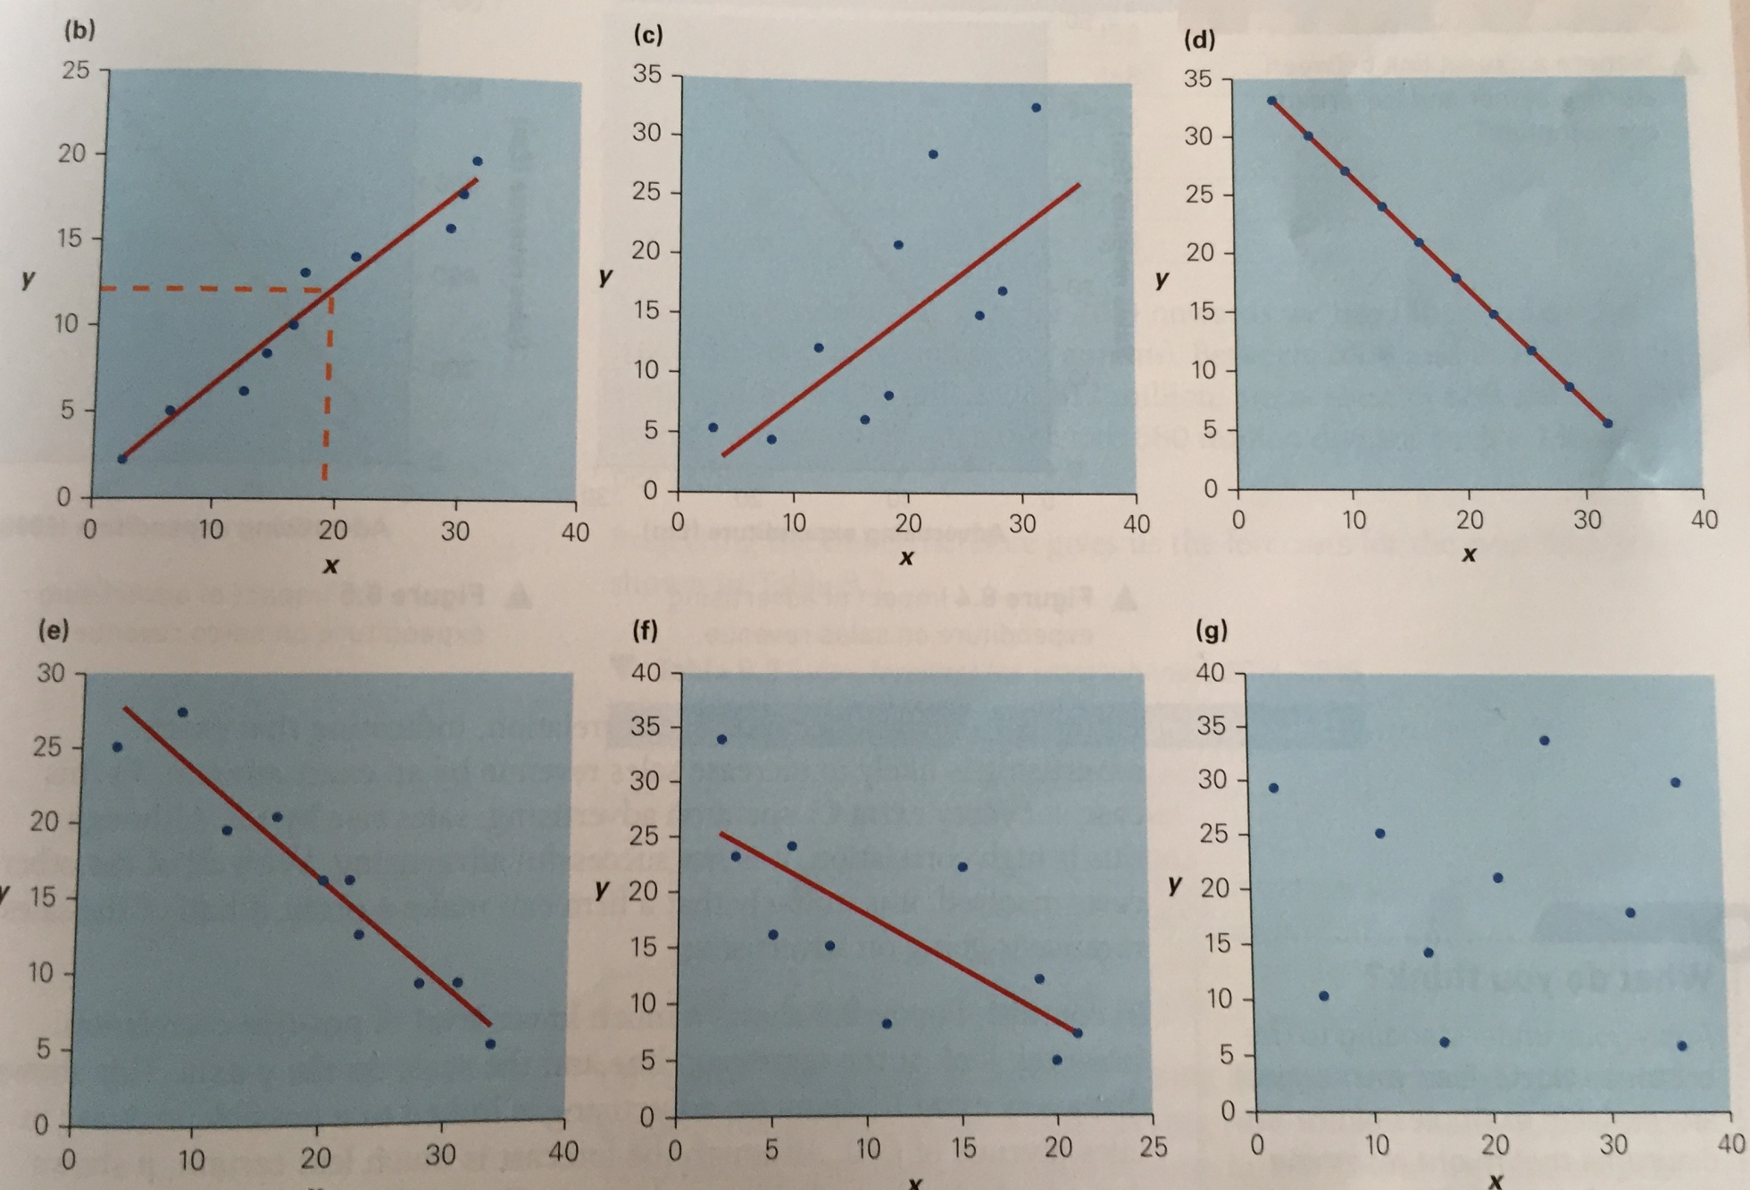

Slide 10
1. Correlation
Independent variable
The variable that causes a change in the other
For example: Increasing the investment in promotion
Dependant variable
The variable that is impacted by the change in the independent variable
For example: The resulting rise in demand

Slide 11
1. Correlation
Positive correlation – A direct relationship between two variables. As the independent variable increases the dependant variable increases.
For example, as more is spent on advertising sales increase.
Negative correlation – An inverse relationship between two variables. As the dependant variable falls the independent variable rises and vice versa.
For example, as investment in training increases product defects falls.
No Correlation – There is no link between the two variables.
Correlation can also be expressed numerically as a value between +1 (positive correlation) and –1 (negative correlation).
The closer the figure is to +1 or –1 the stronger the positive or negative correlation.

Slide 12
Correlation: Task 1
Task:
Match up the variables below that you believe are correlated. Explain how they are correlated and analyse the knock-on effect to the business.
Consumer income
Demand
Innovation (Number of new product launches)
Staff training
Demand
Research and development spending
Sales
Marketing budget
Productivity/customer service quality
Price increases

Slide 13
Causal Link
Key term: Causal link – A link between two sets of information or types of behaviour.
Before drawing any conclusions that there is a link between 2 sets of information, it is essential that a causal link is discovered.
It is logical to expect that more hours of sunshine will cause more ice-cream sales
However, if it was found more people bought overcoats in the summer, there would be no logic suggesting temperature caused this behaviour
You would have to look for other factors – shops getting rid of old stock
Once a causal link is discovered, correlation can be used to identify the extent of the link between 2 sets of data

Slide 14
Research and discuss: How are the terms ‘correlation’ and ‘causation’ related?
Give five examples of correlation in the business world (positive and negative).
Give five examples where variables appear to be correlated but there is no causation.

Slide 15
2. Confidence intervals
Key term: A confidence interval (or margin of error) – The plus or minus figure used to show the accuracy of statistical results arising from sampling.
No estimated data can be 100 per cent reliable.
Confidence intervals help businesses to understand how reliable an estimate is and how confident they can be to act on the data when planning strategy and making decisions.
A confidence interval might be +/- 4% meaning that if a survey showed a 36% chance of an outcome, it could be +/- 4% of this figure – between 32 and 40%
A confidence interval gives the percentage probability that an estimated range of possible values includes the actual value being estimated.
For example: a 90 per cent confidence level means that a prediction will be correct 9 times out of 10 (90 per cent of the time).
Most businesses will use 95 per cent as their choice of confidence level when using data in decision-making.

Slide 16
2. Confidence intervals: Example
A business might wish to carry out research on consumers view’s of their new product. However it would be impossible to survey everyone in the UK.
The company could survey 2,000 people so the data collected would be accurate for those surveyed but would not be 100 per cent accurate for the rest of the UK.
A confidence interval can be created to give the range of possibilities and accuracy of the data in making decisions. The firm might predict that there is a 97 per cent chance that the overall trend −for example, that the majority of consumers liked the product− would be found.
The confidence interval in this example is 97 per cent, and the likelihood that the outcome if done again is outside the estimated range is 3 per cent.
If data had a confidence interval of 97 per cent it would mean that if a wide range of samples were taken the same data/answer would be found in 97 per cent of the samples.
Therefore it would not be found in 3 per cent of the samples in the long term.

Slide 17
Factors influencing the confidence interval
Sample size – the larger the sample size, the more sure a business can be that the answer provided by a sample is a true reflection of the opinion of the total population
Population size – this represents the target population for the product/service being surveyed. Population size only has a minor impact on the confidence interval. A given sample size can be almost as accurate in predicting the behaviour of 50,000 people as it is in predicting the behaviour of 50 million people
Percentage of sample choosing a particular answer – if a very high or very low percentage of people choose a particular option, there is less margin of error e.g. 98% of sample. But if a more central figure (e.g. 49%) choose an option, then there will be a higher margin of error/confidence interval

Slide 18
3. Extrapolation
Key term: Extrapolation - involves using patterns in past data to predict (forecast) future level of sales for products or services.
It is used to help plan production, staff levels, marketing and to set targets.
It is a crucial part of marketing planning and strategies.
Extrapolation can be used to:
Measure performance of individuals/departments - did they meet the forecast?
Plan production levels and schedules
Workforce planning - How many staff will they need to satisfy demand?
Produce realistic and motivating targets for the company
Marketing department can plan what strategies they will need to hit the forecast

Slide 19
Methods of extrapolation
Ways a firm may extrapolate data to forecast future sales may include:
Asking individual experts’ views, for example, management consultants
Individual management hunches based on past experience
Using back data (past sales figures) and predicting the existing trend will continue, for example, calculating the average change (percentage or actual sales value) for a period of time and then extrapolating data into the future.
Basing predictions on market research data carried out before a product launch
Assuming that patterns will continue into the future, for example, sales increases of 15 per cent per annum will continue into the future.
Forecasting (extrapolating) data visually on graphs by carrying on a trend or through calculation (which is recommended for greater accuracy), for example, percentage changes or average increases.

Slide 20
Extrapolation: Task
Task 1: A firm’s sales have been increasing by a rate of 10 per cent per annum for the first three years of trading. Sales in 2015 were £345,000. Forecast the future levels of sales for the years 2016, 2017 and 2018.
Task 2: Predict the future sales for this market based on the previous years’ sales. (Hint: There is more than one way this could be done)
Task 3: What are the pros and cons of extrapolation/sales forecasting?
Year | Total sales (£m)
2012 | 27.9
2013 | 36.5
2014 | 51

Slide 21
Extrapolation: Task − Answers
Task 1:
10% of £345,000 = £345,000 x 1.10 = £379,500
Do the same for the next 2 years using the figure for the previous year.
2016: £379,500
2017: £417,450
2018: £459,195
Task 2:
Average increase per annum (the trend) = between 2012 and 2014 sales rose from 27.9m to 51m, an increase of 23.1m.
The average annual increase = 23.1m / 3 (number of years) = 7.7m per annum. Therefore add this value each year
2015: 51 + 7.7 = £58.7m
2016: 58.7 + 7.7 = £66.4m
2017: 66.4 + 7.7 = £74.1m
Discussion:
Is this the best way to extrapolate this data? How else could it be done more accurately? Would sales increase at this steady rate? Link your answer to the product life cycle and concept of market growth.
It could be calculated more accurately using a percentage change that changes in line with the rate of change previously or expected change in the market or even consumer income changes or GDP growth.

Slide 22
Extrapolation
Advantages
Used to predict future sales, which can help in planning operations, workforce requirements, marketing efforts, etc.
Can be based on past years’ data
Disadvantages
Not reliable in dynamic fast changing markets, e.g. technology
Does not factor in unexpected external changes (qualitative factors), e.g. economic changes, tastes and fashions, etc.
Useful in steady predictable markets
Can be done relatively quickly at little cost
Assumes past trends will continue
Forecasts may result in a firm only achieving their forecasts rather than actual growth
Data may be biased, e.g. a fast food company carrying out studies on health benefits of some of its ingredients
Forecasts too far into the future will have little value

Slide 23
Benefits of market analysis
Market analysis will allow firms to answer the following questions more accurately:
What opportunities are there in the market?
What should we invest in to be successful? How will it impact the business?
What priorities must we set with our limited budget?
How should we structure our business to take advantage of any opportunities or to respond to any threats?
What are the future trends for the market we operate in?
Is there growth in this market?
What influences consumer demand in this market?

Slide 24
Implications of incorrect forecasting
Will produce poor business planning therefore wasted resources if overestimated, for example raw materials, staff
Are the goods perishable or expensive to store?
Is the workforce flexible and able to adjust?
If managers underestimate the company cannot meet orders - loss of revenue and customer goodwill
May lose market share
To make sure forecasting is accurate and successful the company needs:
Skilled staff, reliable research, established product in stable market, test marketing

Slide 25
The value of technology in gathering and analysing data for marketing decision-making
Firms can use a wide range of modern technology to gather data and analyse their market:
Internet data including websites, social media, blogs
CCTV in store
Store cards, for example Tesco Club Card, Nectar card, Boots loyalty card
Sales data using EPOS
Online questionnaires and internet surveys
The data can then be analysed using various computer software
Advantages
Data can be processed and analysed quickly and in greater depth using ICT to accurately inform sales forecasting (extrapolation)
Customer database can be constructed using consumer data collected. It can then be used as part of an effective direct marketing campaign and to continue to modify and adapt the product portfolio to consumers’ changing tastes
Disadvantages
Too much information can be hard to analyse and may actually slow down decision-making
Trends can be misunderstood and mistakes can be made as data can be gathered too quickly and time may be needed to spot the true trend
Can be costly to acquire the required technology and activities to be able to gather the data. For example, Tesco’s Club Card [programme] costs approximately £500m a year [to run]

