Slide 1
Market mapping

Slide 2
Market mapping
This section covers the following:
What market mapping is
Examples of market maps
Benefits of market mapping
Drawbacks of market mapping

Slide 3
Key words
(The) competition
Companies operating in your market or market sector
Gap in the market
An area on a market map where few or no existing brands operate, implying a business opportunity to fill an unmet consumer need
Market map
Measuring where existing brands sit on a two-factor grid, e.g. young/old compared with high price/low price

Slide 4
What is market mapping?
Market mapping is a way of measuring where existing products sit on a two-factor grid.
Example: Young/old compared with high price/low price.
A market map should consist of the key features of the market on the diagram.

Slide 5
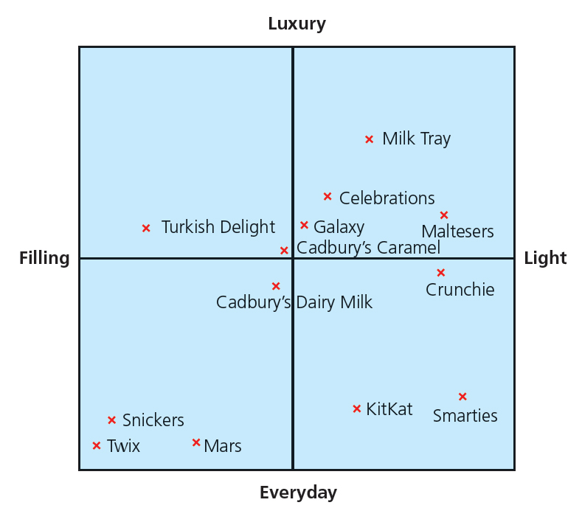
Example market map – Chocolate
Key features of the chocolate market could include:
Luxury vs everyday chocolate
Filling vs light
The diagram shows how a market map might look.
To gain this information means a lot of market research which is time expensive.
From customer opinions and looking at the market map a business like Cadbury might decide to fill the gap for a product on the top left of the diagram.
A luxury filling style chocolate appears to have little competition at the moment.

Slide 6
Key factors when market mapping
Business often use what they regard as the most important factors to complete a market map:
High priced/low priced
For young/for old
For men/for women
Careful market research needs completing to decide on the right factors

Slide 7
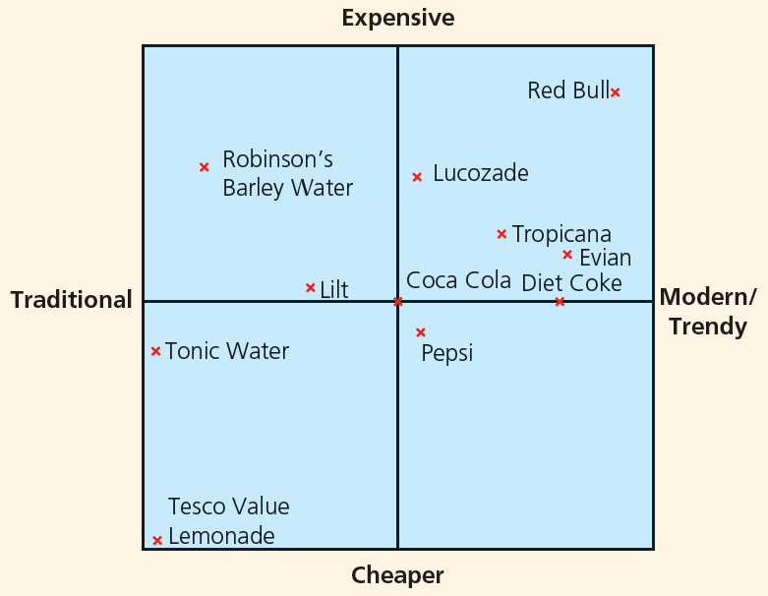
Benefits of market mapping
Market mapping is a clear way of displaying products in a market and potential gaps to fill
It summarises a lot of complex information in an easily accessible diagram.
Factors can be adapted for numerous business situations.
Market mapping shows where competitor products are positioned in a market compared to the others.

Slide 8
Drawbacks of market mapping
Deciding what are the most important factors is very difficult.
Market mapping requires a large investment of time and money in market research to provide a reliable market map.
The map is only based on two variables so may not give the full picture,
Maps can show bias and could lead to wrong and expensive business decisions.

Slide 9
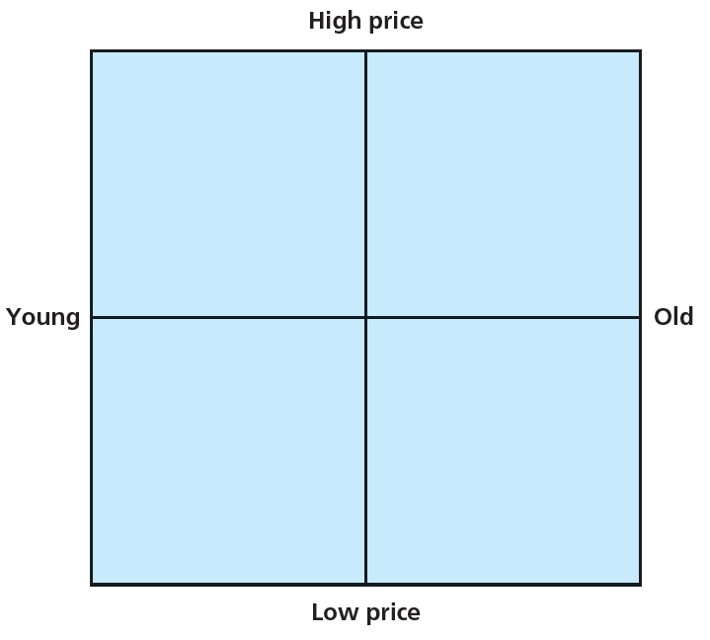
Summary questions
Write down or discuss the answers to these questions.
Draw the market map shown.
Place the iPhone 6s in the correct place in the mobile phone market. Explain your choice.
Place Tesco value baked beans in the grocery market. Explain you choice.
Give one drawback for a small business of using market mapping. Explain your choice.
Give one benefit of using market mapping for a car manufacturer? Explain your choice.

