Slide 1
Marketing mix

Slide 2
Marketing mix
This section covers the following:
What the marketing mix is
Product
Price
Promotion
Place
A successful marketing mix
How the elements of the mix work together

Slide 3
Key words (1)
Marketing mix
The factors that are combined and used by a business to persuade customers to buy a product. There are four factors, product, price, promotion and place, known as the 4 Ps.

Slide 4
What is the marketing mix?
Marketing means understanding and communicating with customers so they buy a product.
The marketing mix is the factors that are combined and used by a business to persuade customers to buy a product. There are four factors, known as the 4 Ps:
Product
Price
Promotion
Place
The 4 Ps affect all aspects of the iPhone

Slide 5
Key words
Product
Targeting customers with a product that has the right blend of functional and aesthetic benefits without being too expensive to produce

Slide 6
Product
Market research can help a business identify a product or service that customers need.
Example: Heck sausages found that customers wanted healthier sausages so created chicken sausages.
Heck Foods

Slide 7
Key words
Price
Setting the price that retailers must pay, which in turn affects the consumer price

Slide 8
Price
For some products the price needs to be low to gain high sales – such as milk.
For other products, low price may be seen as low quality by customers – such as champagne.
Ideally businesses want to create an image that makes customers willing to pay high prices. Rolls Royce and Ford both make cars, but due to Rolls Royce being a luxury brand, customers are not put off by the very high prices of the cars.

Slide 9
Key words
Promotion
Within the 4Ps, promotion means all the methods that a business uses to persuade customers to buy, e.g. branding, packaging, advertising, to boost the long-term image of the product and short-term offers.

Slide 10
Promotion
Promotion means all the methods that a business uses to persuade customers to buy a product, such as branding, packaging and advertising
The promotional methods used depends on factors such as how long the product has been on sale, what the product is, competition in the market and the target market. Tesco may run a ‘buy one get one free’ (BOGOF) promotion on a new breakfast cereal.
Subway sponsor Liverpool Football club to raise awareness of their business with supporters and those that watch TV.
BOGOF ad

Slide 11
Key words
Place
How and where the supplier is going to get the product or service to the consumer. It includes selling products to retailers and getting the products displayed in prominent positions.

Slide 12
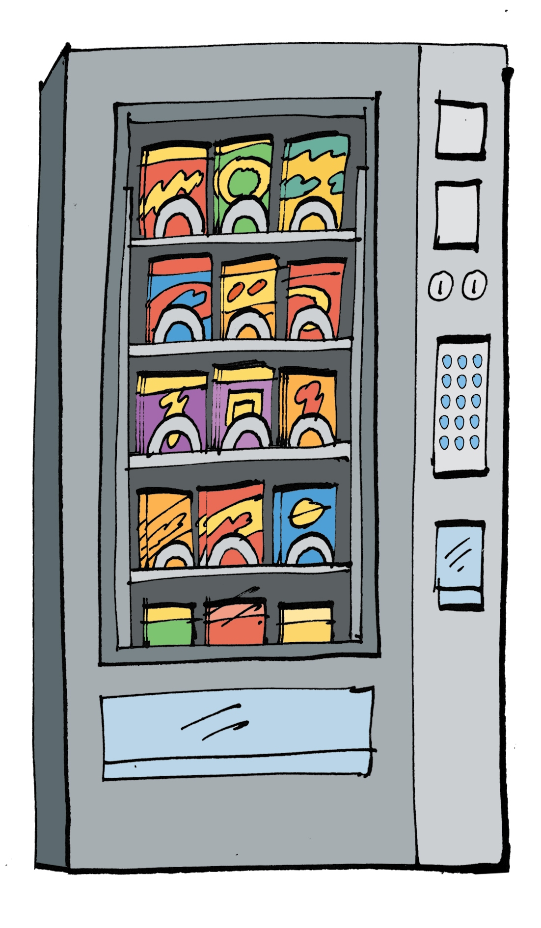
Place
Normally businesses want to sell their products in as many outlets as possible
For other businesses, the product has special features that help dictate how it has to be distributed. Petrol is very dangerous and can only be sold at stations that meet strict safety standards
Businesses with luxury products tend to restrict the distribution of their items to add to its exclusivity
Example: Rolex watches has strict rules on who and where its luxury watches can be sold and do not sell any watches on the internet.
Think about the impact of selling online – smaller businesses may use websites to sell their products because they are much cheaper tha using stores.
Rolex

Slide 13
Successful marketing mix
Businesses must co-ordinate all four parts of the mix to show customers that the product or service meets their needs.
Products that are marketed as luxury need higher prices and select places of sale and promotion.
Products that are technically advanced need a price that shows customers the product is unique, together with promotion aimed at customers with technical knowledge.

Slide 14
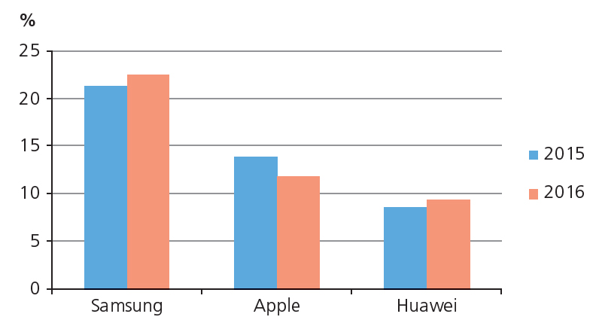
The competitive environment
Businesses need to constantly review and tweak their marketing mix to remain competitive, e.g. alter price or promotion.
Example: Apple saw a fall in its global sales of phones between April – June 2016.
Apple has reduced its prices to compete.
Look at the chart – which business is the closest to Apple’s market share?

Slide 15
Changing consumer needs
Consumer trends change over time.
The marketing mix needs to reflect these changes in order for a business to continue to be successful.
Example: Eating out is increasingly popular in the UK as a regular event, rather than a treat.
£54.7bn is expected to be spent on eating out in 2017.
Restaurants like MacDonald’s are redesigning their menus to take this into account by creating more premium burgers.
Restaurants are also being redesigned to move from a place to eat quickly to one where customers spend more time.
Eating out

Slide 16
The impact of changing technology
Technology can make accessing products and services easier in terms of place
10 years ago, to watch a film or play a video game would need a trip to a shop in the high street, such as Game
With the rise of streaming services such as Netflix and online downloads of games, companies such as Game have had to change their marketing mix to accommodate this shift in buying habits.
The table shows other impacts of technology on the marketing mix.
Changing technology | Effect on marketing mix
The rise of m-commerce (mobile commerce): e-commerce on-the-go via apps rather than websites | Promotional offers have to be simpler and clearer so that they can be understood quickly
Hi-tech but lighter materials have made airplanes much more fuel-efficient and less polluting than in the past | There’s an opportunity for flight prices to be cut, especially on long-haul flights

Slide 17
Summary questions
Write down or discuss the answers to these questions.
What are the 4Ps?
Give one benefit to Amazon of being based on the internet.
Give one reason the sale of petrol is not normally based on its price.
Why would a luxury brand restrict the sale of its products to only large department stores?
Give an example of a new trend that Kellogg’s may have to take into account with their products.

