Slide 1
3.4 – Using the marketing mix:
Place

Slide 2
Learning outcomes
Making marketing decisions: Using the marketing mix
What you need to know:
The elements of the marketing mix (7Ps)
The influences on and effects of the changes in the elements of the marketing mix
Distribution (Place) decisions

Slide 3
3.4 – Making marketing decisions: Using the marketing mix: Place
Price
Place
Product
Promotion
People
Process
Physical environment

Slide 4
Building analysis chains
Increased profit
Location of the business
What is the link?
What connects these two key terms. Write down an analysis chain using the template.

Slide 5
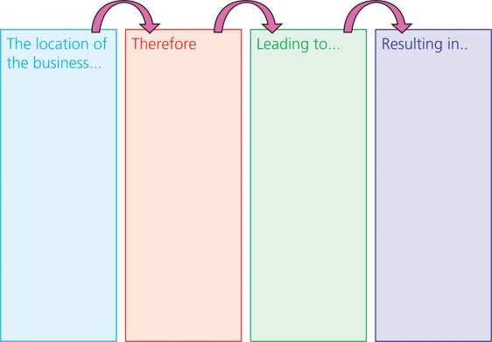
Building analysis chains

Slide 6
Importance of location
Convenience – This is one of the most crucial factors (especially for supermarkets) in why people buy from certain businesses. You wouldn’t travel miles to find a cheaper product if its convenient to stay local and buy it
Accessibility – traffic jams in high streets can have a factor on consumers’ decisions to buy, and travelling a long distance means you're less likely to buy a product
Cost-of-access – shopping centres may offer free parking to entice customers – at the detriment of high street shops
Reputation – private doctors in Harley Street or fashion houses in Knightsbridge benefit from the prestige attached to the address
Localisation – some retailers benefit from being near competitors when prices need to be compared (electrics/estate agents/solicitors)

Slide 7
Placement in the point of sale

Slide 8
Number of outlets
Persuading retailers to stock products is crucial to success. The more outlets that stock the product, the more sales a business can generate. There are several ways businesses can try to do this:
Promotional campaigns
Providing extra facilities or attractive displays
Offering high profit margins to retailers
Paying generous commission to sales staff
Increasing brand variety
Getting sole brand deals (McDonald’s and Coca-Cola)

Slide 9
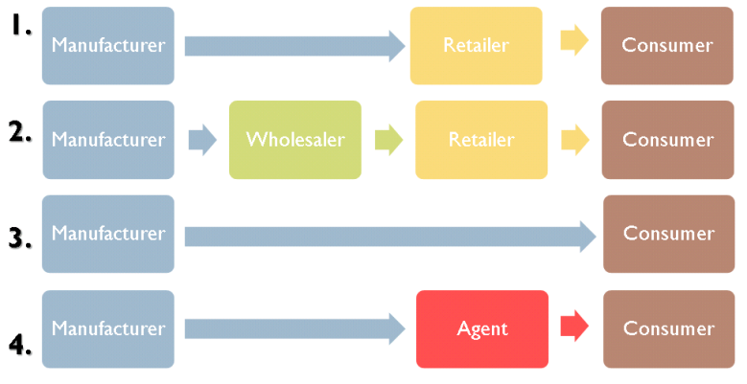
Channels of distribution
Distribution channels are routes through which a product passes in moving from the manufacturer (producer) to the consumer.
Notes:
Number 3 = zero level distribution channel
Wholesalers and retailers:
These help to distribute products to customers.
Using them can reduce the producer’s profits.

Slide 10
Channels of distribution
Producer – who supplies the product or service. For example Cadbury produces chocolate and Direct line provides insurance.
Selling directly to consumers will help to maximise profit margins as profit is not lost in intermediary’s mark ups. However this is often difficult to achieve for many types of products.
Notes:
Number 3 = zero level distribution channel
Wholesalers and retailers:
These help to distribute products to customers.
Using them can reduce the producer’s profits.

Slide 11
Channels of distribution
Wholesaler - These firms purchase products in large quantities (bulk) and supply them in smaller quantities to retailers (break bulk). Producers prefer to sell to bigger wholesalers than to lots of smaller retailers as it reduces their distribution costs and the time taken to negotiate. For example, Costco and Makro.
Notes:
Intermediaries – organisations that provide a service and help get products from the producer to the customer

Slide 12
Channels of distribution
Retailer – Shops that sell goods/services to the final customers. Supermarkets such as Asda, retail chain stores such as Topshop, franchises such as McDonalds and small independent shops are all examples of retailers, at the end of the chain of distribution.
Retailers help producers get their products to their consumers on a wide scale.
Notes:
Number 3 = zero level distribution channel
Wholesalers and retailers:
These help to distribute products to customers.
Using them can reduce the producer’s profits.

Slide 13
Channels of distribution
Agent – A firm that never actually owns the good but will facilitate buyers and sellers coming together to make a deal happen. Examples include estate agents (property) and travel agents (holidays, e.g. hotels and flights). They help to bring all the different holiday firms together making it easier for the consumer and producer.
Notes:
Number 3 = zero level distribution channel
Wholesalers and retailers:
These help to distribute products to customers.
Using them can reduce the producer’s profits.

Slide 14
Methods of distribution
There are a wide variety of different methods a firm could use to get their goods to the consumer. These include:
Direct to the consumer through various methods such as:
Websites (e-commerce)
Catalogues and mail order
Representatives and sales teams
Vending machines
Telesales – selling over the phone
Using retailers
Selling to retailers through wholesalers
Using agents

Slide 15
Multi-channel distribution
This exists when firms use more than one type of distribution channel
Think about Mars – corner shops, vending machines, wholesalers, retailers.
This can provide flexibility for customers – stores can have goods delivered to home if not in stock – what are the benefits of this?
Different methods can work together to meet customer needs:
Customer visits promotion on website, clicks link and is sent to CS advisor who can talk about product, customer can click-and-collect, ordering online and paying online or in store, choosing where to pick it up

Slide 16
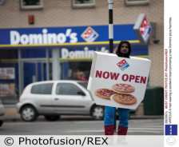
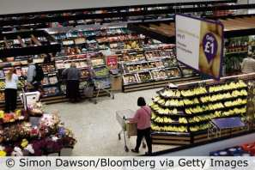
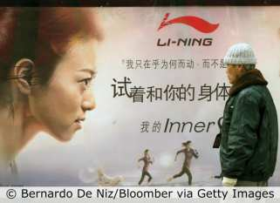
Discussion: What will influence the types of distribution method a business may use?

Slide 17
Betterware and Avon
Betterware and Avon are two of the most famous home shopping companies. They both use a declining method of distribution which involves using sales representatives who visit consumers directly going door to door. Avon has representatives in over 140 countries and as of 2010. had annual sales of $10.8 billion worldwide. Betterware has over 5,000 distributors who visit homes door to door. They have a purpose-built office and warehousing complex in Birmingham which deals with 5 million customer orders every year. For both Avon and Betterware customers can purchase products through their door-to-door representatives, by post, phone or online.
Discuss: What do you think are the advantages and disadvantages of having a door-to-door sales force?
Notes:
Answers might include:
l Door-to-door sales is quite labour intensive as opposed to selling online and relies on people
being in.
l It can provide a personal touch and enable the sales people to talk to and learn from customers as well
as explain to them the benefits of the products.
l By knocking on doors you may find people to buy who would not have thought of contacting you on
their own.
Quick questions

Slide 18
Factors influencing the choice of distribution method
Profit margins – The more intermediaries in the distribution channel the lower the profit margin for the producer
Distribution costs – Often retailers help firms to ensure their products are available all over the country/world without having to pay their own distribution costs
Control required over display and brand image – For example Tesco and Levi’s court battle and high-end fashion brands wanting to only be available in suitable retailers and their own stores
Proximity – How close does the firm need to be to its customers?
Convenience for customers and type of product – For example, convenience goods must be easier for consumers to access as they often rely on impulse purchases
Size of the retailer – larger retailers will want to bypass the wholesaler
Type of product – perishable products will generally, not be sold to a wholesaler, but items such as newspapers ma be to keep distribution costs down
Technology – the internet has had a huge influence on how products are sold

Slide 19
Discuss: Why is place important?

Slide 20
Example: Levi Strauss vs. Tesco
In July 2002 supermarket giant Tesco lost a landmark legal fight for the right to sell designer goods at low prices.
It stated that Tesco was not allowed to sell cut price Levi jeans without permission from the US-based clothes giant. Levi spent four years fighting the case.
Tesco sold Levi jeans at approximately half the price recommended by Levi Strauss. It achieved this by purchasing the goods form wholesalers in European countries where they were sold more cheaply.
Levi Strauss complained about the impact it felt this would have on the brand image it had built.
The European Court of Justice also supported Levi's case stating that retailers could not sell branded goods from outside Europe without the consent of the trademark owner.
A Levi representative said the ruling would protect their brand which was their ‘most valuable asset’. ‘For 130 years the Levi's name has been a promise of outstanding quality and value…This decision allows us to carry on keeping that promise.’

Slide 21
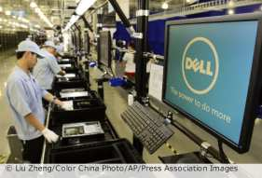
Exam-style questions
In the 1990’s Dell only sold computers through its website, mostly direct to other businesses. As it grew it started to focus on selling to consumers with the same direct model. It helped them to keep overheads lower and to manage their stock better using a just-in-time stock control method. However as the company diversified into other products like flat-screen television and focused more on consumer sales it found that it could not keep up with rivals by selling purely online. It expanded into using retailers across the world, such as PC World in the UK.

Slide 22
Exam-style questions
Questions:
Analyse two benefits of its approach of selling directly to the consumer. (6 marks)
Evaluate whether Dell were correct to begin selling its computers through retailers such as PC World? Justify your view. (16 marks)
Exam tip:
Consider both sides of the argument and whether it truly is the best method of distribution.

Slide 23
Summary
Place is a vital part of an integrated marketing mix.
Product must be convenient for consumers and available in the right place at the right time.
Different distribution methods will be suitable for different types of firms.

