Slide 1
3.4 – Using the marketing mix:
Product

Slide 2
Learning outcomes
Making marketing decisions: Using the marketing mix
What you need to know:
The elements of the marketing mix (7Ps)
The influences on and effects of the changes in the elements of the marketing mix
Product decisions

Slide 3
What are the 7P’s?

Slide 4
The elements of the marketing mix (7Ps)
Price
Product
Promotion
Place
People
Process
Physical Environment
Marketing mix: The elements of a firm’s approach to marketing that enables it to satisfy and delight its customers.
The marketing mix is commonly described as the 7Ps
The 7Ps are manipulated by the firm to maximise sales and profit, create a brand, develop customer loyalty and to create a unique selling point/proposition (USP)
Unique selling point/proposition (USP) – A key feature of a product that differentiates it from its rivals.

Slide 5
The influences on the marketing mix
A wide range of issues can influence the design of a firm’s marketing mix:
Financial situation of the firm – For example, cash flow and levels of profit. This will influence the budget firms are able to set for promotion and the types of promotion they use. It may also impact the prices they set, the levels of training they offer staff and its impact on customer service.
Target market and the firm’s knowledge of the market through market research – What market segment does the business aim at? What level of income do they have? What are their interests, tastes and fashions? How price sensitive are they? What do they look for in a product?
Stage in life cycle – Is it a start-up firm or one which has been operating for a long time?

Slide 6
The influences on the marketing mix
Market forces – How much competition does the firm face? Does the firm operate in a mass or niche market? Does it sell to consumers or other businesses? Who holds the power, buyers or suppliers? – see Porter’s Five Forces
Consumer tastes and fashions
The price elasticity of demand
Existing reputation and brand image of the firm
The impact of technology – E-commerce and social media usage – Does it sell its goods/services online; does it use social media? Does its target market prefer these methods? What is the rate of technological change in the market in marketing methods, production methods, components and types of products sold?

Slide 7
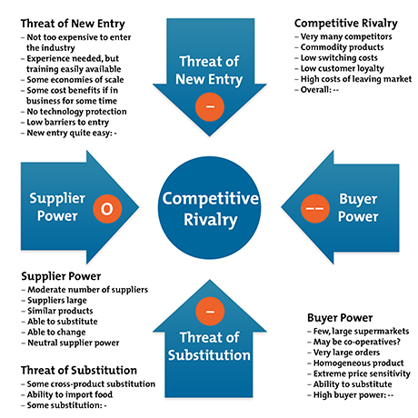
Market forces
Porter’s 5 forces

Slide 8
Quick task
Create a mindmap of the different influences on the marketing mix

Slide 9
Making marketing decisions: Using the marketing mix: Product
Price
Product
Promotion
Place
People
Process
Physical environment

Slide 10
Product decisions
The marketing mix will be most strongly influenced by the type of market the firm operates in.
Firms will make decisions on whether their target market is consumers or other businesses.
Therefore they will operate in either industrial (business-to-business) markets or the consumer market
Different marketing approaches are needed to convince firms and consumers to purchase products.

Slide 11
Industrial (or business-to-business) marketing
There are some key issues which firms must deal with when they operate in industrial markets which differ from selling directly to consumers. These may include:
Promotion − focuses on facts and being informative rather than being persuasive
Larger quantities are purchased
Specialist purchasing staff who will be much more knowledgeable and harder to negotiate with and influence by marketing methods
Greater emphasis on quality and other factors such as after-sales service and maintenance, particularly if selling machinery, vehicles, etc.
Price and mark-up is very important
Credit is often expected which can impact cash flow and liquidity
Building relationships and customer service are vital for repeat sales and long-lasting loyalty
Time − Often negotiation plays an important part and can take time
Delivery conditions − Firms often expect more specialist delivery unlike consumers who may seek out the retailers

Slide 12
Consumer marketing
When firms compete in consumer markets they will compete in different markets depending on what type of consumer product they sell.
Consumer products are purchased to satisfy a range of different consumer needs and wants.
There are three main categories of consumer products:
Convenience products: Low-priced products which are frequently purchased by most market segments with minimum thought or planning, often out of impulse or habit. For example, food and cleaning products.
Shopping products: Products which consumers value and give some thought and planning to so do not buy as often as convenience goods. The value of the brand name is often important so there is high added-value and therefore higher prices charged. For example, clothing and electrical goods.
Specialty products: Products with high price tags which consumers are very selective about and will generally research in some detail. For example, luxury cars, cruises, expensive wines and champagne or jewellery.
Two other categories of consumer products include:
Emergency products: Products bought due to sudden events to solve a problem
Unsought products: Unplanned impulse purchases as a result of a firm’s marketing efforts and a customer’s exposure to them, for example, persuasive sales staff or product discounts.

Slide 13
Quick task
Outline 3 differences between industrial and consumer marketing

Slide 14
Using the marketing mix: Product
Product: The good/service provided by a business
A product should possess key features that ensure it appeals to the needs of its target market, such as:
Functionality
Reliability
Durability
Appearance and aesthetic qualities
Value in relation to price charged
Safe and abiding by legislation, such as health and safety legislation, emissions control, trade descriptions, environmental laws, etc.
Convenient to use and ergonomic
Suitable packaging
Fashionable and in keeping with social trends

Slide 15
Quick task
Why is it important to have a product that meets customer needs?

Slide 16
Developing products: Influences
Other factors:
Market research – Spotting new trends in the market, potential gaps or better understanding consumers tastes to identify potential new products. Firms that launch new products purely based on consumers’ tastes found from research are known as ‘market-led’.
Own personal experience
Solving your own personal needs and problem solving
Innovation and new ideas – for example, James Dyson
Environmental awareness – New products developed to help solve environmental problems
Ideas from other countries
Notes:
Copy onto handout.

Slide 17
Quick task
Create a mini mindmap showing the different influences on product development

Slide 18
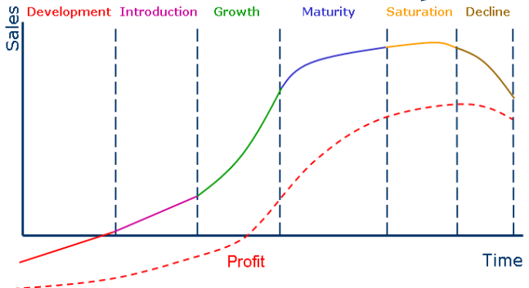
Discussion: Can you think of example products at each stage of the product life cycle?
The product life cycle

Slide 19
The product life cycle
Research and development - Market research is carried out, the idea for the product is developed and prototypes produced.
This is an expensive period for the company as no sales are made because the product is not yet available.

Slide 20
The product life cycle
Introduction/Launch - Sales begin and start slowly as consumers are getting to know the product. This stage will involve a lot of expenditure on promotion and publicity. The firm will need to convince their distributors to stock the new product (For example, PlayStation 4 in 2013).

Slide 21
The product life cycle
Growth – At this stage sales are accelerating (if it is well advertised). People are beginning to buy more of it and it is becoming successful. More outlets for the product need to be found. The firm should start to break even on costs and begin making a profit. (For example, NFL in the UK).

Slide 22
The product life cycle
Maturity – At this stage the sales rate begins to slow down. Perhaps a competitor has launched something similar that is impacting sales, or customers want something new. At this stage the firm should consider introducing some different versions of the product to keep sales up. (For example, Cadbury’s Dairy Milk, Heinz Ketchup).

Slide 23
The product life cycle
Decline – Sales begin to fall as the product becomes less popular. At this stage a firm will need to make a decision, should sales be boosted again by spending more on marketing or should the product be withdrawn form the market. (For example, CD sales).

Slide 24
The product life cycle and new product development
Discussion:
At what stage of the product life cycle would it be best to begin investing in research and development of the next product?

Slide 25
The product life cycle and new product development
Discussion:
At growth, as if you leave it too late by the time the product has been developed and launched your existing product may have reached decline, by which time income will be lower which will make investing in promotion difficult impacting cash flow.

Slide 26
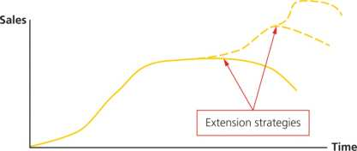
The product life cycle: Extension strategies
At the decline stage of the product life cycle a firm has a few options:
Withdraw the product
Let it decline in sales until it no longer generates profit or contributes towards paying fixed costs and breaking even
Improve the product sales by using an extension strategy
Extension strategy:
Strategies taken to extend the life cycle of the product

Slide 27
Discussion questions:
Why might a company want a range of products rather than focusing on one?
What problems might a firm face if they have too many products at the same stage of their life cycle?
What strategies might a firm use to extend their product life cycle?

Slide 28
The product life cycle: Extension strategies examples
Possible extension strategies might include:
Reposition the brand into a niche market
Targeting new market segments with the same product (market development), for example, Johnson’s Baby shampoo targeting adult users
Updated design of the product and/or packaging
Modifying ingredients
Change of sizes of products

Slide 29
The product life cycle: Extension strategies examples
Increase usage of the product, for example, Kellogg's ‘twice a day’ cereal diet
New advertising campaigns
Move into foreign markets (market development). X-box have been able to do this with the opening up of the Chinese market as have numerous car brands in emerging markets such as India.
Create a new brand image
Improve customer service or after-sales service

Slide 30
Task
Complete the product worksheet

Slide 31
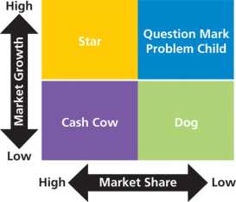
The Boston Matrix
A method of analysing the products in a firm’s product portfolio based on the market share they have in the market and the growth in the market in which they operate.
A product portfolio is the range of products a business may sell, for example, Proctor & Gamble owns brands such as Arial, Duracell, Wash & Go, Fairy, Gillette and Pampers.
This tool allows firms to analyse where their products are in relation to their market and to make decisions about what needs to be done.

Slide 32
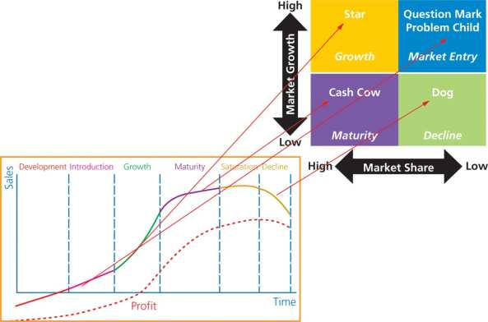
Links between the product life cycle and the Boston Matrix
Each stage of the Boston Matrix can be related to the stage of the product life cycle as seen in the diagram.

Slide 33
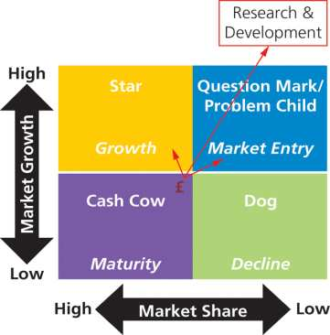
The product life cycle, Boston Matrix and product development
Income from cash cows can be used to promote star and question mark products in the portfolio whilst also being used to pay for research and development of the next new product.

Slide 34
Stage of the Boston Matrix
Question mark/Problem child
Stars
Small market share in a fast-growing market
Products may be a success or they may fail
They may generate little income
Products have an uncertain future
Need large investment in marketing to create awareness and brand image
Mostly new products onto a market
For example, Microsoft X-box when it was launched in 2001
Large share of a fast-growing market
Highly successful products which may generate high incomes
Usually expensive to market/promote
Money needs to be spent to ensure it retains its position in the market; to stay ahead of the competition
The aim is to develop into a cash cow
For example, the Apple iPad

Slide 35
Stages of the Boston Matrix
Cash cows
Dogs
High market share in a slow-growing market
Often mature products with well established producers
They generate more income for the business than is invested
Little room in the market for further growth
Much of the promotion is already done
Good product awareness in the market for the product
May become dogs if not managed well
Money generated from cash cows is used to fund a company’s other star and problem child products to help them succeed (milking)
For example, Heinz Baked Beans, Nescafe Original
Low market share in low-growth markets
These products may no longer generate profit but may contribute towards fixed costs
Firms may want to withdraw products from the market or let them decline until no longer making a positive contribution to the firm
May be taking up resources that could be used for other products
Could turn around these products with extension strategies
May be held for strategic reasons, for example, to maintain market share
For example, video recorders, personal MP3 players

Slide 36
Quick task
Divide an A4 sheet of paper into 4. In each quarter, explain the different characteristics of the Boston Matrix.

Slide 37
Discussion
Of what value are product portfolio analysis tools such as the product life cycle and the Boston Matrix to firms?
Useful in setting objectives
Help to identify successful and failing products
Can help to make important decisions on what products need to be modified or withdrawn
Better understanding of when to invest in developing new products
Helps to decide what products to put resources into
Can analyse if any market segments are not being catered for to avoid missed opportunities
Useful in planning growth strategies and budgets

Slide 38
Developing products
Product development: When a firm creates a new or improved good or service.
The process has 5 stages:
Generate ideas: Research and development will be completed, often at great costs. Ideas will be discussed and market research will be completed to identify gaps in the market and consumer tastes.
Analyse potential product ideas: Firms will analyse how feasible the idea is and decide if it will fit in its product portfolio.
Develop product: The product will be made, tested with prototypes and/or simulation using CAD/CAM.
Test market: Some firms will complete this stage, where the product is released in particular areas to test customer reaction.
Launch product: Once the firm feels the product is ready it will be released and the firm will finally begin to receive revenue to cover the costs already incurred.

Slide 39
What would influence new product development?
Market research gathered – Spotting a gap in the market, rivals actions and consumer tastes
Skills and expertise of staff and managers - What can the firm do? Can they spot new opportunities and gaps in the market to gain first mover advantage?
Management experience and knowledge
Technology advancement - in products, components, marketing methods, and production methods
Competitors actions and product launches
Scientific developments and innovation – Dyson and Apple develop new ideas without necessarily researching what customers want
Social trends, fashion changes, consumer needs and wants, for example new environmental products and green technology, healthy living, etc.

Slide 40
Quick task
Mindmap the different influences on product development

Slide 41
Example and Exam-style questions
The National Football League (NFL) of America is expanding its product offering further in 2015 after selling over 250,000 tickets in 2014 to its three sell-out games, included the Miami Dolphins vs. Oakland Raiders; the Detroit Lions vs. Atlanta Falcons and the Dallas Cowboys vs. Jacksonville Jaguars. In 2015 the three games will feature the first-ever division game in the UK between the New York Jets and Miami Dolphins. They have received lots of positive reviews from UK fans − about the games and pre-game entertainment− who hope to see further games in the UK and possibly their own team within the next decade. Many believe that the NFL is in the growth stage of the product life cycle as sales of merchandise at the games, tickets and viewing figures on Sky TV are all rising rapidly but have not yet reached their maximum. The fans generally have mid to high incomes and are willing to pay high prices for products and tickets as the product is becoming increasingly price inelastic.
Notes:
Beth: Insert pictures of NFL and London games

Slide 42
Example and Exam-style questions
Questions:
The NFL is entering the growth stage of its product life cycle in the UK. Analyse the possible ways in which the company may respond to this. (6 marks)
Evaluate the success of this new strategy? Justify your view. (16 marks)
Exam tip:
It is a good technique to use PEE (point, example, explain) to build stronger paragraphs and enhance your exam technique. (See next slide for an example.)
Notes:
Beth: Insert pictures of NFL and London games

Slide 43
PEE: Building strong paragraphs
Point – Make a relevant point to answer the question.
Example – Make the point relevant to the specific circumstances of the case given.
Explain – Explain the knock-on effects to the business and its relevant stakeholders whilst staying focused on the question. Use key connectives such as therefore, thus, this means, as a result, this will lead to… etc.

Slide 44
Exam tip: Example paragraph
Application: Connectives to help build analysis
P One way the NFL may respond to this is by reducing its costs on promotion.
E Currently the NFL is building a loyal and growing customer base who are willing to regularly attend games and purchase merchandise. It has received high levels of positive reviews on the games and pre-game entertainment which has lead to the tickets being fairly price inelastic.
E This may mean that the NFL can reduce their expenditure on advertising, which is currently very expensive as they can rely more upon word of mouth. As a consequence this cutback in costs may allow the NFL to keep its prices constant, or to introduce just a small increase, to keep customers relatively happy. This will lead to them improving their profit margins. As a result the firm will be able to reinvest their increased profit into bringing more games to the UK to further grow their product portfolio in the UK.

Slide 45
Summary
Developing new products helps a firm to expand its product portfolio to help spread risk.
Over reliance on one product or one market segment can put the business at major risk if that area declines in sales.
Product development also helps a business to achieve a USP (a unique selling point/proposition) to ensure it has a sustainable competitive advantage against its rivals.
A firm must carefully analyse its product portfolio and ensure it does not have too many of one product type, at one stage of its life cycle or on the Boston Matrix.
Otherwise they may have insufficient funding to pay for all the new products being launched impacting their cash flow, liquidity and chance of survival.

