Slide 1
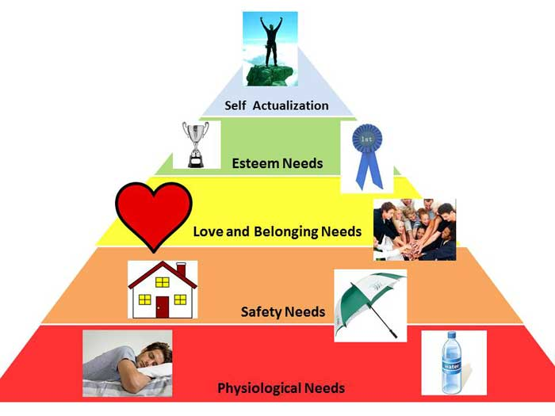
Maslow’s Hierarchy of Needs in the Workplace

Slide 2
Google believe that workers are not motivated just by …… - that they need to be motivated in a number of ways . If possible, all of Maslow’s ………. should be met. Their offices allow people to socialise easily in …………. areas. This meets their ………… needs and also makes them feel valued so meeting their ……. ……….. needs.
People work in teams where staff help each other and can develop ……………… skills, so meeting their need for ……… …………………………….
self esteem pay leisure needs social
creative self actualization

