Slide 1
Methods of growth

Slide 2
Methods of growth
This section covers the following:
What the growth of a business is
How to grow organically
How to grow inorganically – takeovers and mergers

Slide 3
What is business growth?
Business growth is the expansion or success of one or more parts of a business.
Business growth is usually seen as expanding sales, revenue, market share or even entering new markets.
Growth can be internal, known as organic growth.
Organic growth is growth from within the business, such as creating and launching successful new products.
Growth can be external, known as inorganic growth.
Inorganic growth is growing by buying up other businesses or by merging with another business.

Slide 4
Key words
Innovation
Bringing a new idea to the market, such as Warburtons’ clever idea of an extra-large crumpet
Organic (internal) growth
Growth from within the business, such as creating and launching successful new products

Slide 5
How to grow organically – new products
Most businesses start with one product – Heck sausages started with organic sausages.
To grow organically, businesses then introduce a greater range of products. Heck decided to make chicken sausages.
To encourage retailers to stock new products it has to be different and innovative. Heck introduced heart-shaped sausages which helped increase revenue by 130%.
Innovation through research and development (R&D) can help growth.
Example: Dyson’s new hair dryer costs £299 and took 4 years of R&D, opening up a whole new market for the business.
https://www.dyson.co.uk/hair-care/dyson-supersonic-overview.html
Heck sausages
New products
Dyson

Slide 6
How to grow organically – new markets
New markets often mean new countries to sell to, which also means significant costs and a wait for profits.
Challenges include promoting an unknown brand.
Example: Dyson launched its air purifiers in China with the products being hugely successful due to Chinese air pollution – turnover rose by a quarter to £1.7bn.
Being a member of the Single European market has helped UK businesses to sell abroad
Business can launch completely different products to their current range – such as the Dyson hair dryer.
Business can change the way they market their product through the marketing mix.
Dyson

Slide 7
Key words
Inorganic (external) growth
Growing by buying up other businesses or by merging with a business of roughly equal size
Merger
When two businesses of roughly equal size agree to come together to form one big business
Takeover
Obtaining control of another business by buying more than 50 per cent of its share capital

Slide 8
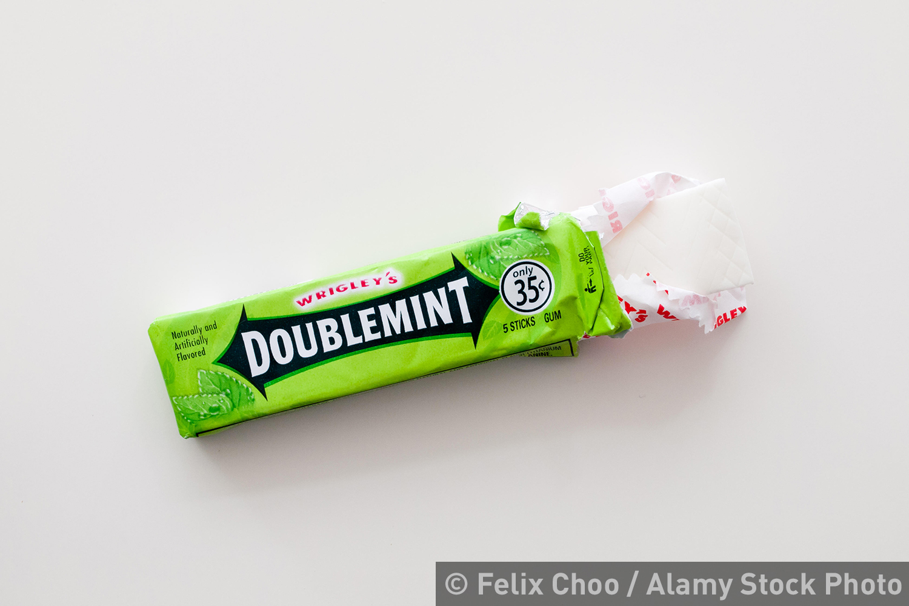
How to grow inorganically – takeovers 1
A takeover is gaining control of another business by buying more than 50 per cent of its share capital.
Example: In 2008, Mars the chocolate business bought Wrigley, the chewing gum maker for $32bn.
Sales of chocolate were static but chewing gum sales were rising.
The combined business had bigger negotiating power with suppliers and supermarkets, and costs could be reduced – such as only needing one set of sales people.

Slide 9
How to grow inorganically – takeovers 2
A takeover starts where owners or shareholders are asked to sell more than 50 per cent of their shares to the company wanting to start the process.
Shares normally end up being sold for a profit.
Once shares have been sold the business takes over full control of the business.
Senior managers in the old business leave and the whole business goes through a process of getting rid of duplication.
Example: When the US company Kraft took over Cadburys for £11.bn in 2010 it immediately closed a factory in Bristol with the loss of 400 jobs.
Kraft

Slide 10
How to grow inorganically – mergers
A merger is when two businesses of roughly equal size agree to come together to form one business.
Growth is extremely quick and both businesses can benefit from expertise and skills developed individually.
Because growth is so quick, mergers can be badly managed and businesses clash, leading to disagreement and duplication of costs.
Example: The £5bn merger of Dixons and Carphone Warehouse, possibly as products of mobile phones and electrical were a good match. In 2015 profits rose to £375m.
Example: In 2005 eBay bought Skype for $2.6bn and then sold it for $1.9bn, as they could not integrate their different technologies.

Slide 11
Summary questions
Write down or discuss the answers to these questions.
True or false? A merger is a method of growing organically.
What is the definition of organic growth?
Give one benefit of organic growth.
Give one reason why a business would decide to grow through a takeover.

