Slide 1
Ownership and liability

Slide 2
Ownership and liability
This section covers the following:
Limited liability
Unlimited liability
Advantages and disadvantages of three types of business start up

Slide 3
Key words
Unlimited liability
Treating the business and the individual owner as inseparable, therefore making the individual responsible for all the debts of a failed business
Sole trader
A business run by one person, who has unlimited liability for any business debts
Bankrupt
When an individual is unable to pay their debts, even after all personal assets have been sold for cash

Slide 4
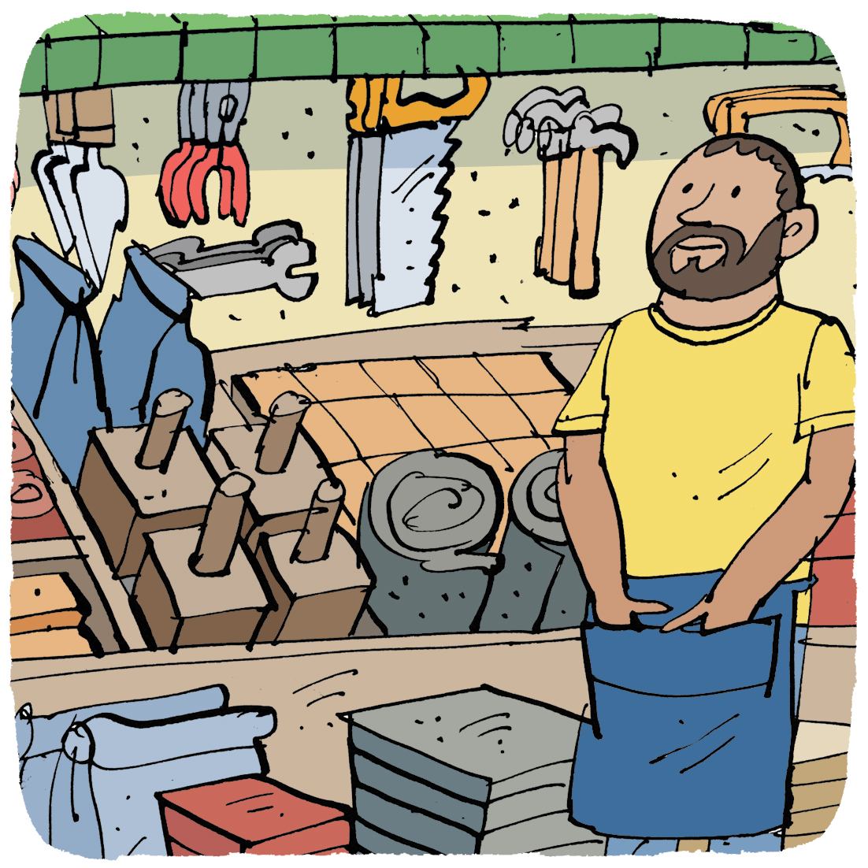
Unlimited liability
Unlimited liability is where the owner of the business is responsible for all the debts it incurs, no matter how large.
A person running their own business without forming a limited company is called a sole trader.
Where a person starts a business with others without becoming a limited company this is called a partnership.
A benefit of starting a business as an unlimited liability is there are less costs when setting up and less legal formalities.
A drawback of starting a business with unlimited liability is if the business fails the owner is responsible personally for all the debts.
If the person cannot pay the debts they could lose their personal possessions or be made bankrupt.

Slide 5
Key words
Limited liability
Restricting the losses suffered by owners or shareholders to the sum they invested in the business
Private limited company (Ltd)
A small family business in which shareholders enjoy limited liability
Incorporation
the process by which a new or existing business registers as a limited company. A company is a legal entity with a separate identity from those who own or run it.
Companies
Business whose shareholders have limited liability. These are either a Private Limited Company (Ltd) or Public Limited Company (PLC), They have to publish their accounts.

Slide 6
Limited liability & private limited companies
Private limited companies are normally family owned businesses with the family as shareholders and enjoying limited liability.
To set up a private limited company an application form is filled in and sent to Companies House, along with a payment.
Benefits of being a limited company include:
Ownership is divided amongst the people who own shares. 51% of the shares means the owner keeps control of the business.
If the business fails, there is limited liability
A drawback of a limited company is that there are more costs to running it – such as
having to get an accountant to publish accounts.
Finance the purchase of assets with a long life, e.g. property purchases
Expand the business such as increasing the size of a factory.

Slide 7
Advantages and disadvantages
INSERT aw 19_03
 | Advantages | Disadvantages
Sole trader | Can start trading immediately Have 100 per cent control | Unlimited (personal) liability Have 100 per cent responsibility for the business, making holidays a problem
Partnership | Liability is spread between the partners Complementary skills may enhance the business | Unlimited liability, including for business debts caused by partner There may be clashes as one partner seeks overall control
Limited company | Limited liability Can sell shares to outside investors | Risk of losing control Cost of starting up and cost of getting accounts audited every year

Slide 8
Summary questions
Write down or discuss the answers to these questions.
Name a type of business that has unlimited liability.
Give one advantage of setting up as this type of business.
Give one disadvantage of setting up as this type of business.
What does it mean if a person goes bankrupt?
What is a business called that has shareholders?
Name a benefit of a business with limited liability.

