Slide 1
Place

Slide 2
Place
This section covers the following:
Methods of retail distribution
Gaining retail distribution
E-tail distribution or e-commerce

Slide 3
Key words
Distribution
How ownership changes as a product goes from producer to consumer

Slide 4
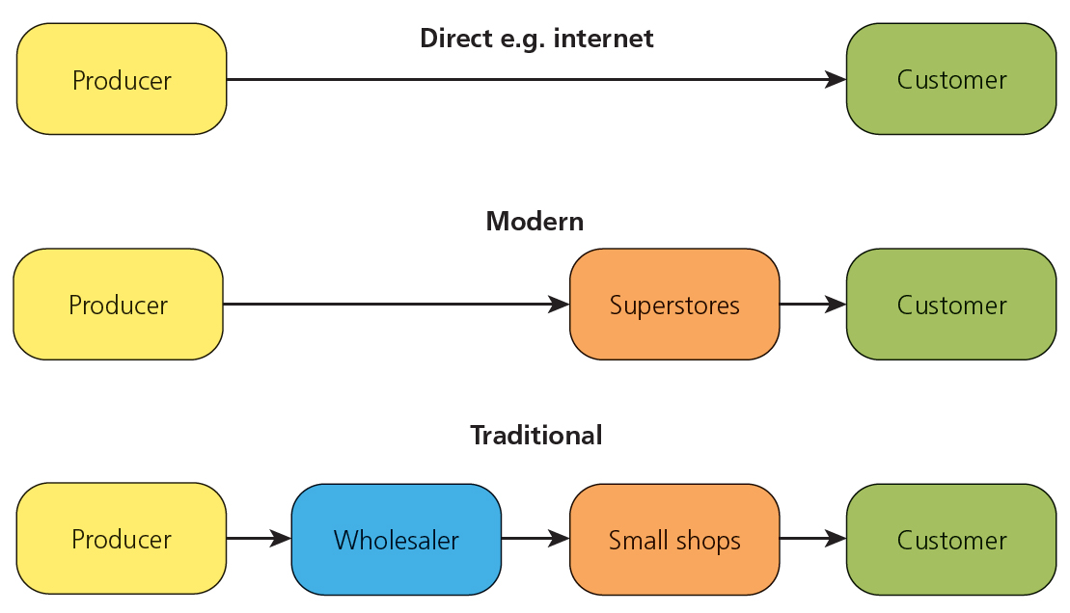
Methods of retail distribution
Distribution is how ownership changes as a product goes from producer to consumer.
Choosing the correct approach is key to the success of a product. There are three main methods – see the diagram.
The traditional channel means producers sell in bulk to wholesalers, who then sell smaller amounts to retailers
The modern channel is where the producer sells directly to the retailer – such as supermarkets buying milk directly from farmers.
Finally, the direct channel is where the producer sells straight to the customer, e.g. Apple store or Next mail order.
Can you name one advantage and disadvantage of selling through each method of distribution?

Slide 5
Key words
Retailer
A shop or chain of shops, usually selling from a building in a high street or shopping centre

Slide 6
Gaining retail distribution 1
A retailer is a shop or chain of shops, usually selling from a building in a high street or shopping centre.
In order to distribute, a business needs to:
show their brands are unique to the customer
have strong marketing support behind the brand, e.g. a good sales team that can show customers the benefits of buying the product over competitors
make a profit acceptable to the retailer.

Slide 7
Gaining retail distribution 2
To keep stock over a period of years:
promotional offers need to be offered, such as half price sales
customers need to be persuaded to try products at full price.
Can you name one advantage and one disadvantage of selling products from a shop to the customer?
Advantages | Disadvantages
Customers can touch, hold, feel, smell and wear products before buying; makes it easy to compare with rival products You can choose a lean piece of meat or a nearly-ripe piece of fruit; ecommerce can’t match that You can take it away instantly; not even same-day delivery can match that | ‘Going shopping’ is time consuming, especially when it seems important to make full comparisons (e.g., visiting lots of shops) Choice can be overwhelming, leading to too much time being spent You have to carry everything; especially hard for those without a car (30 per cent of households)

Slide 8
Key words
E-tailer
An electronic retailer; in other words purchasing electronically, either by e-commerce or, more likely these days, mobile commerce (m-commerce)

Slide 9
E-tail distribution or e-commerce? 1
An e-tailer is an electronic retailer such as Amazon. There are two types of e-commerce:
direct sales that go straight from the producer to the customer, such as Dyson vacuum cleaners from their website
sales through an e-tailer. Amazon sells Dyson vacuum cleaners to customers, so it goes from producer to e-tailer to customer.
A benefit of direct sales is that the producer receives all the profits from the customer instead of having to receive a reduced profit for sales in bulk to the e-tailer.
Benefits of the e-tailer approach is there are no costs for a physical shop and they can buy in bulk, undercutting high street stores.
The table shows some of the benefits and disadvantages of online retail.

Slide 10
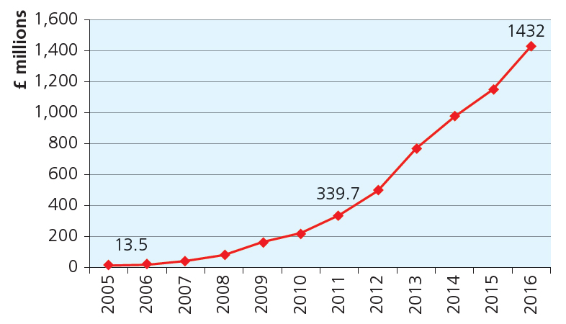
E-tail distribution or e-commerce? 2
E-tailers are increasingly becoming the first method of buying products due to their ease of use and accessibility. For example, Amazon reviews are unbiased and pull no punches on products.
Look at the graph showing clothing e-tailer ASOS sales.
If you were starting a business selling clothes would you be a retailer or an e-tailer? Explain why.

Slide 11
Summary questions
Write down or discuss the answers to these questions.
What are the three main channels of distribution?
Draw a diagram of the three main channels of distribution.
Give one benefit of being a retailer.
Give one drawback of being a retailer.
Give one benefit of being an e-tailer.
Give one drawback of being an e-tailer.

