Slide 1
Putting a business idea into practice
Revision Session

Slide 2
Learning Objectives
To understand the different concepts from unit 3 (AO1)
To be able to apply the concepts from unit 3 (AO2)
To be able to analyse the concepts from unit 3 (AO3)
To be able to evaluate the concepts from unit 3 (AO4)

Slide 3
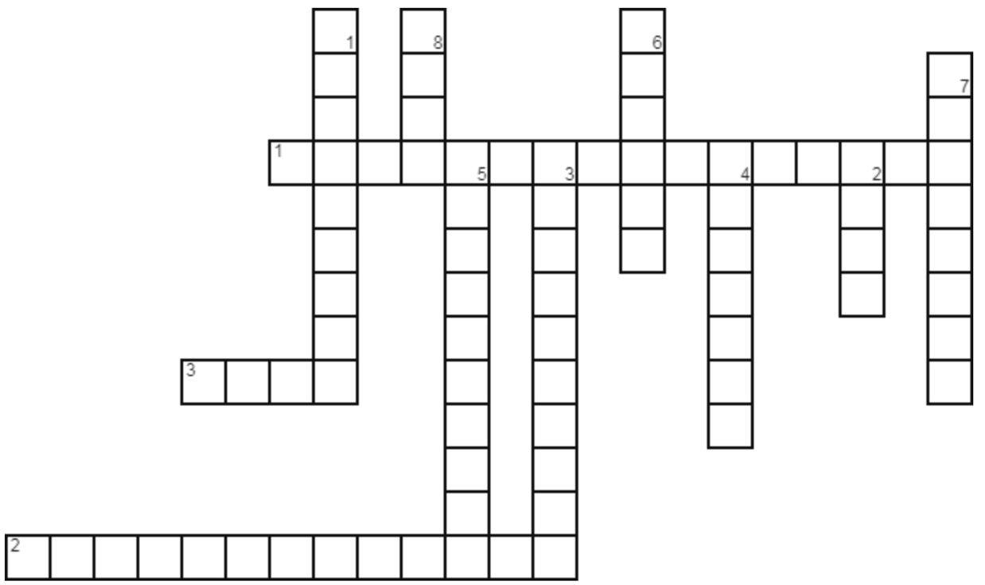
Please complete the crossword sheet (extension tasks are on the back)

Slide 5
Business A sells its products for £2.50. Over the last year it has sold 150,000 products, which each cost 85p to make. The business has fixed costs of £200,000.
Business B sells its products for £300. Over the last year it has sold 20,000 products, which each cost £190 to make. The business has fixed costs of £2,500,000.
1) Which business is more profitable?
2) What is the break-even point for each business?
3) Give two ways in which a business can become more profitable.

Slide 6
This session will be a mix of short, medium and long answers
There is a cheat sheet to help you throughout that has definitions and calculations on it

Slide 7
1.3.3 Cash and cash-flow
The importance of cash to a business:
To pay suppliers, overheads and employees
to prevent business failure (insolvency)
The difference between cash and profit.
Calculation and interpretation of cash-flow forecasts
cash inflows – How do we calculate this?
cash outflows – How do we calculate this?
net cash flow – How do we calculate this?
opening and closing balances – How do we calculate these?

Slide 11
1.
a)
b)
2.
(AO1) One way in which the cash position would change is that they would receive more cash inflows.
(AO2) A 50% off sale would attract more customers.
(AO3) This would lead to more cash flowing into the business.
Another way it could potentially affect the cash position is:
This is because:
The impact of this would be:

Slide 12
One way it could potentially affect the cash flow of the business is:
This is because:
The impact of this would be:

Slide 13
1.3.2 Business revenues, costs and profits
The concept and calculation of:
Revenue - How do we calculate this?
fixed and variable costs – Give examples of each of these
total costs - How do we calculate this?
profit and loss - How do we calculate this?
Interest - How do we calculate this?
Break even level of output - How do we calculate this?
Margin of safety. - How do we calculate this?
Interpretation of break even diagrams
The impact of changes in revenue and costs
break even level of output
Margin of safety
Profit and loss.

Slide 15
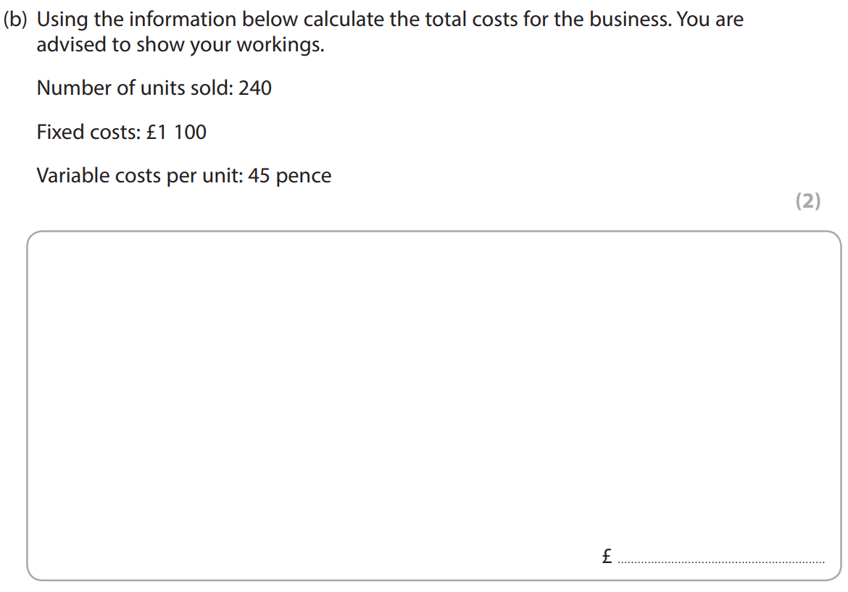

Slide 22
Plenary
Kahoot time!
https://create.kahoot.it/kahoots/my-kahoots
Take your iPads and log in to the game!

