Slide 1
Elasticity of demand

Slide 2
Price elasticity of demand (PED)
Key term: This measures the degree to which demand will change in response to a change in price
PED = percentage change in quantity demanded
percentage change in price
Elastic goods = an answer greater than 1, where demand will change with a price change
Inelastic goods = Less than 1, where demand is relatively unresponsive to a change in price
Unitary elasticity = an elasticity of 1; any price change is cancelled out by the demand change
Elasticity will always be a negative figure as when price goes up demand falls and when prices fall demand rises. The relationship between these variables is opposite and therefore negative.

Slide 3
Example
A product increases its price from £100 - £110 and demand falls from 240 units to 180 units
% change = Original figure – New figure x 100
Original figure
To calculate % change in price:
(100 – 110)/100 * 100 = 10%
Then do the same for demand:
(240-180)/240 * 100 = -25%
Therefore using the equation PED
PED = -25% / 10% = -2.5 (Price elastic)
Exam tip:
There will be no need to calculate this in the examination

Slide 4
Calculate whether demand is elastic or not:
Price rises from £11 to £13
Demand falls from 76 units to 52 units.

Slide 5
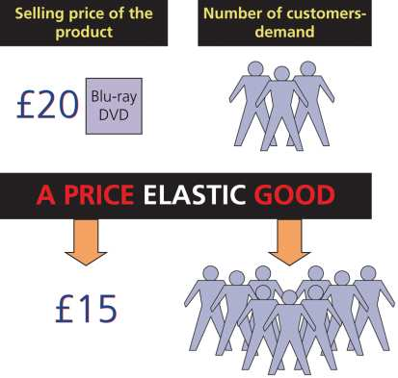
An illustration of price elasticity

Slide 6
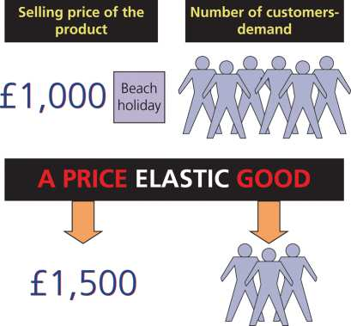
An illustration of price elasticity

Slide 7
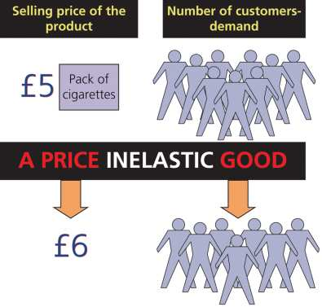
An illustration of price elasticity

Slide 8
Effect of price elasticity of demand on sales revenue and profit
Inelastic demand – if demand for a good is inelastic, when its price rises the quantity demanded falls by a smaller percentage. This means that the impact of the price increase will outweigh the relatively small percentage change in demand, so sales revenue will increase
As you are producing less, costs will be lower, so costs will fall as revenue increases
A PRICE RISE WILL ALWAYS INCREASE SALES REVENUE AND PROFIT IF PRICE ELASTICITY OF DEMAND IS INELASTIC
A PRICE FALL WILL LEAD TO LOWER SALES REVENUE AND PROFIT IF PRICE ELASTICITY OF DEMAND IS INELASTIC

Slide 9
Elastic demand – if demand for a good is elastic, when its price rises the quantity demanded falls by a larger percentage. This means that the impact of the price increase will be outweighed by the relatively large percentage change in demand, so sales revenue will decrease
this doesn’t necessarily mean a decrease in profit
it will be cheaper to produce less goods so costs will fall as well as income
if costs fall by more than income, profit will still be improved
if costs fall by a smaller amount, profit will fall
THUS, A PRICE RISE WILL ALWAYS DECREASE SALES REVENUE IF PRICE ELASTICITY OF DEMAND IS ELASTIC, BUT THE EFFECT ON PROFIT WILL DEPEND ON COST SAVINGS
IN THE CASE OF A PRICE FALL, THE SALES REVENUE OF A GOOD WITH A PRICE ELASTIC DEMAND WILL ALWAYS INCREASE. HOWEVER, THE UANTITY DEMANDED RISES AND SO PRODUCTION COSTS WILL RISE. THEREFORE, IT IS IMPOSSIBLE TO PREDICT THE EFFECT ON PROFITS WITHOUT KNOWING THE COSTS OF PRODUCTION

Slide 10
Unitary elasticity – if demand for a good is unitary, sales revenue will be the same whether price rises or falls
A price rise would then be advisable if the business is aiming to increase profit, because this means a lower volume of sales would be required, which would enable production costs to fall
However, the business may not increase price if it has other aims, such as increasing market share

Slide 12
Factors influencing price elasticity of demand
Necessity – the more necessary a product, the more inelastic the demand (e.g. Bread and milk) However, a reduction in price will not tend to encourage buyers to purchase more
Habit – the stronger the habit, the more inelastic the demand (e.g. Cigarettes, alcohol, chocolate, TV)
Availability of substitutes – the greater the availability of close substitutes, the more elastic the demand – think petrol in a city or the countryside
Brand loyalty – the greater the level of brand loyalty, the more inelastic the demand (e.g. Someone who insists on wearing Armani)
Proportion of income spent on a product – consumers will be less concerned about price rises if a product takes up a small percentage of their income and vice versa (e.g. Matches/cars)
Consumer income – Wealthier people are less worried about price increases. Wealthier areas can increase prices because demand for their products will be more inelastic
Time – if price changes, consumers will often look around for alternatives before deciding to switch to another product. Therefore, price changes tend to have less impact in the short term

Slide 14
Task: Price elasticity of demand
Produce a table (like the one below) that highlights the main factors that influence elasticity (Add others if not listed)
Two firms are competing in intense markets and are trying to improve their overall profit. Suggest how they should improve their competitiveness in terms of price and costs.
An electronics firm with a PED of -0.6
A handbag manufacturer with PED of -4.3
Factors influencing price elasticity of demand | How they influence elasticity
Necessity or luxury good
Habit forming
Brand loyalty
Proportion of income spent on the product
Availability of substitutes

Slide 15
Income elasticity of demand (IED)
Key term: This measures the degree to which demand will change in response to a change in consumer income
IED = percentage change in quantity demanded
percentage change in income
Income elastic goods = an answer greater than 1, where demand will change by a more significant amount with a income change. Consumers will wish to purchase more as they become wealthier; usually luxury goods such as holidays and electrical goods.
Income inelastic goods = Less than 1, where demand is relatively unresponsive to a change in consumer income. Consumers do not generally demand a great deal more as they gain in income; usually necessity products, such as basic foods and fuel.
Unitary income elasticity = an elasticity of 1, any consumer income change is cancelled out by the demand change.
Income elasticity will usually be a positive figure as when consumer income goes up demand will usually increase. However some goods known as inferior goods will have a negative IED as demand will fall as consumers’ incomes rise, e.g. supermarket own brands.
Firms cannot control the levels of income in a market, so the main use of income elasticity is to forecast demand.

Slide 17
Summary
There are a wide variety of techniques discussed in this unit that firms can use to analyse their market.
For many it is essential to understand their market and consumers to ensure they anticipate and satisfy consumer demands to stay ahead of rivals.
Firms that are market-led aim to learn what consumers want and provide it.
However other firms focus more on an asset-led approach and produce unique products they know will change markets and that consumers will want, creating a sustainable competitive advantage.
The level of market analysis needed by a business and how successful it is will depend on the type of market the firm is in and the strengths of the business in terms of its staff, skills and brand.

