Slide 1
Price

Slide 2
Price
This section covers the following:
The importance of price
Pricing strategy for different market segments
How technology influences pricing strategies
Pricing strategies at different stages of the product life cycle

Slide 3
Key words
Profit margins
Profit as a percentage of the selling price (one unit) or as a percentage of total sales revenue (for the business as a whole)
Price
Amount of money given in payment for a product or service

Slide 4
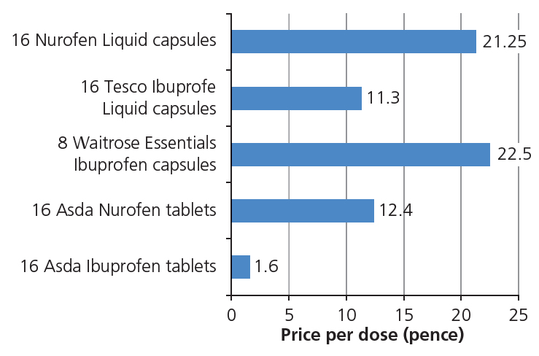
The importance of price
Price is amount of money given in payment for a product or service.
A low price can be set in order to try and sell a large amount of the product, normally with low profit margins, e.g. value baked beans.
A high price can be set which will normally result in low sales but higher profit margins, e.g. Ferrari sports cars.
Where a product has a strong brand image they can often charge a higher price for the same product.
Example: See the chart showing prices of ibuprofen tablets with the same contents.
Give a reason why Waitrose can charge much more than Asda for the same products.

Slide 5
Pricing strategy – mass market
Mass market price is likely to be low as businesses try and compete for as many customers as possible, i.e. large sales and smaller profits per sale.
Mass markets suffer from little seasonal effects, e.g. toilet rolls sell equally well in January as at Christmas.
Mass markets are not based on one region of the country alone, sales are high everywhere.
There are high levels of consumption on a regular basis. Milk is used most days by most people.

Slide 6
Pricing strategy – niche markets
A niche market is based on the wants and needs of customers who want a product that is different to most other people.
The number of products sold in a niche market are comparatively small.
The business makes a profit by having higher profit margins on every product it sells.
Example: Bentley, the luxury car maker, now make an SUV for those customers who can afford £135,000 price tag.
Example

Slide 7
How does technology influence pricing?
As customers can now search the internet for products, this has affected how prices are set by business.
Comparison sites exist for many products, so pricing strategies have to reflect this.
Example: Uswitch provides comparison for mobile phone contracts. On the EE network, one phone is £40.99 per month m with 10GB of data, while the same phone on O2 is £42.99 per month with 12GB of data .
Cutting costs to reduce prices and improving customer service are key to sales.
For some businesses, the internet has created a market for products that would otherwise be difficult to sell, e.g. Etsy specialises in allowing very small specialist shops to access customers worldwide.
Example
Etsy

Slide 8
Pricing strategies and product life cycle
Introduction: where new products start with lower introductory prices to encourage customers to try out a product, e.g. when Japanese cars were first brought to the UK market pricing was lower than UK cars.
Growth: where established products can have a price increase as customers have more loyalty to the product, e.g. once Japanese manufacturers had gained customer loyalty prices increased.
Maturity: is the opportunity for the business to raise the price of successful products to make maximum profits without losing much demand, e.g. Toyota cars sell at a premium as they have gained many loyal customers.
Decline: where sales are starting to dwindle.
If the product is outdated lower prices may gain more sales.
If the product has loyal customers the price may increase to increase profits even as sales drop.
Product Life Cycle

Slide 9
Summary questions
Write down or discuss the answers to these questions.
What is a mass market?
Does a mass market pricing strategy normally mean a low or high volume of sales?
Give an example of a niche market product.
Would sale volume be high or low for a niche market product? Explain why.
Give one way e-commerce affects the price of a Samsung TV.
What would the pricing strategy be in the maturity stage of a product?

