Slide 1
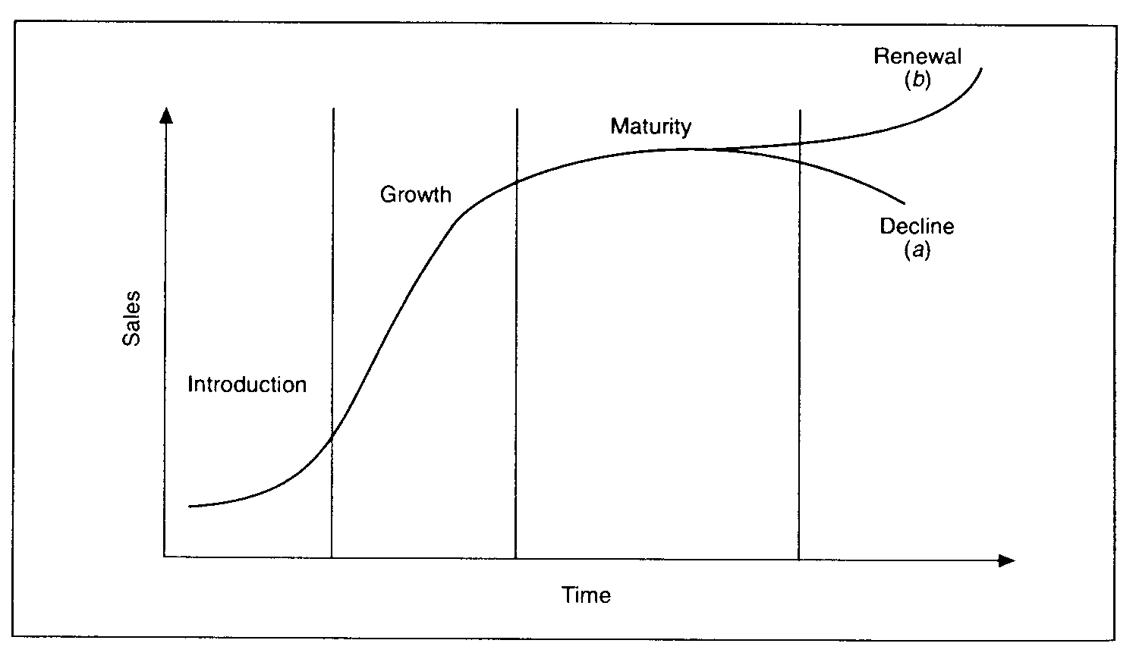
Give 6 different extension strategies and explain the problems that businesses might face implementing them.
What’s happening here and what potential problems will a business face? Give 2 examples of products at this stage.
Extension Strategy
What’s happening here and what potential problems will a business face? Give 2 examples of products at this stage.
What’s happening here and what potential problems will a business face? Give 2 examples of products at this stage.
Development
What’s happening here and what potential problems will a business face? Give 2 examples of products at this stage.
What’s happening here and what potential problems will a business face? Give 2 examples of products at this stage.
Extension: Why must a business continually assess where there products are on the life cycle? Use real examples to support your answers. (9 marks)

