Slide 1
Product

Slide 2
Product
This section covers the following:
Design and the design mix
The importance to a business of differentiating products/services
Product life cycles
Extension strategies

Slide 3
Key words
Aesthetics
How things appeal to the senses: do they look great, smell good, feel nice, sound solid (the ‘kerplunk’ of a BMW door shutting) or taste great?
Economic manufacture
Making the product cheaply enough to make it profitable
Function
How well the product or service works for the customer. For example, are the beds comfortable at a hotel, does the smartphone take sharp photos?

Slide 4
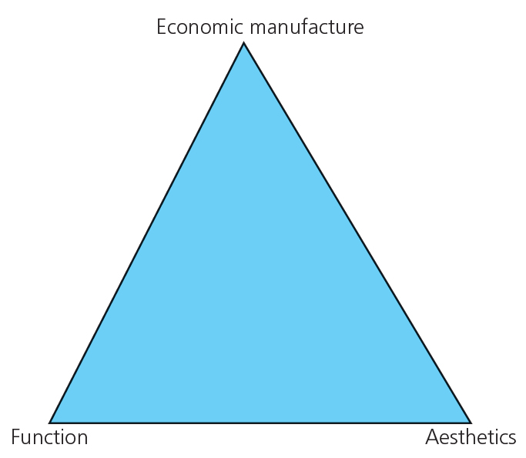
Design and the design mix
The product or service needs to match the needs and wants of the customer to be successful.
The design mix tries to balance the three main design priorities to ensure the right product is created – see the diagram.
Economic manufacture means making the product cheaply enough to make it profitable. In 2017 ArcelorMittal, a steel producer announced a car door that is 34% lighter and cheaper to make.
Function is how well the product or service works for the customer. Dyson vacuum cleaners do not lose suction even if it is getting full of rubbish.
Aesthetics is how things appeal to the senses, e.g. the wrap-around screen of the Samsung Galaxy edge appeals to the luxury mobile customer as it is unique.

Slide 5
Key words
Product differentiation
The extent to which consumers see your product as being distinct from its rivals

Slide 6
Why differentiate between products?
Product differentiation is the extent to which consumers see your product as being distinct from its rivals.
Example: The Tesla car company was the first to make an electric car that had a real-world range of over 250 miles, along with a dashboard that has a giant ‘iPad’ instead of switches.
High differentiation means customers not only buy the product but become loyal to it.
Well-designed products help create a brand identity which customers recognise, e.g. the Apple logo or the Mercedes star.
Not only do these products stand out from others in the market, but they allow the business to charge different prices from their competitors.
Write down a product that stands out for chocolate, drinks, clothing, and gaming. Why?
Tesla

Slide 7
Key words
Product life cycle
The theory that every product goes through the same four stages of introduction, growth, maturity and decline

Slide 8
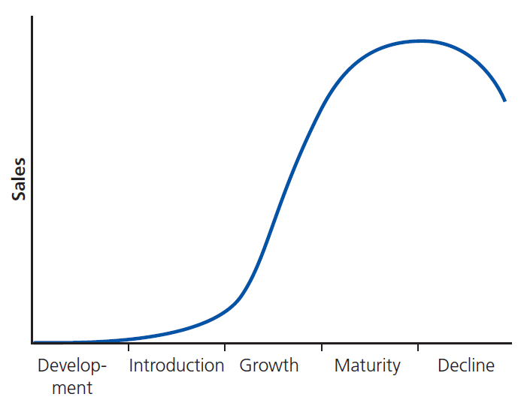
What is the product life cycle?
Product life cycle is the theory that every product goes through the same four stages of introduction, growth, maturity and decline.
The product life cycle is a prediction of how long a product can continue to make a profit.
Some products have very short life cycles, e.g. pop music – songs become popular very quickly before we get tired of hearing them!
Other products have many years of profitable life. Lego has been made with the same blocks since 1947.
Can you think of another product with a short product life cycle?

Slide 9
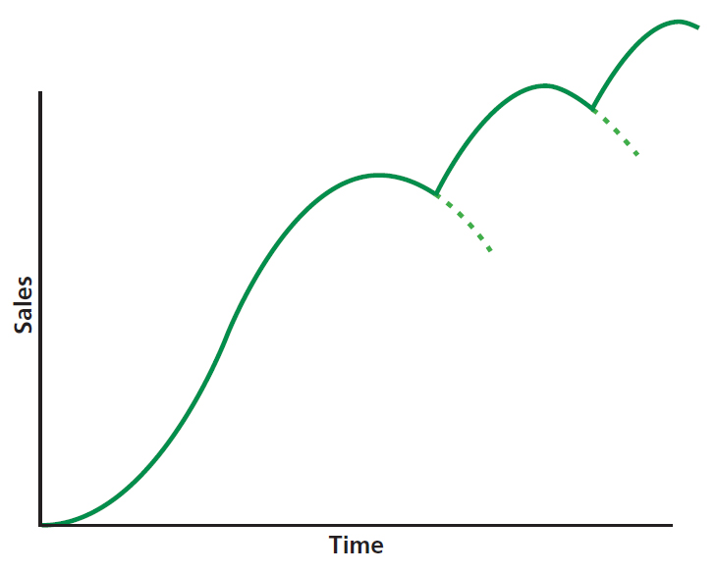
Product life cycle continued
Introduction is where the business spends a lot of time and money researching the product and what the customer needs and wants, using market research.
Growth is where the market begins to see the product across a wider number of outlets. Price will be high and sales and profits will be rising.
Maturity is where the market is full of the product and sales are no longer growing. Cash is flowing into the company and profits are high.
Decline is where the sales and profits of the product start to decline as new or improved products are taking customer sales. Products are eventually withdrawn from the market.

Slide 10
Key words
Extension strategy
An attempt to prolong sales of a product for the medium to long term, to prevent it from entering its decline stage

Slide 11
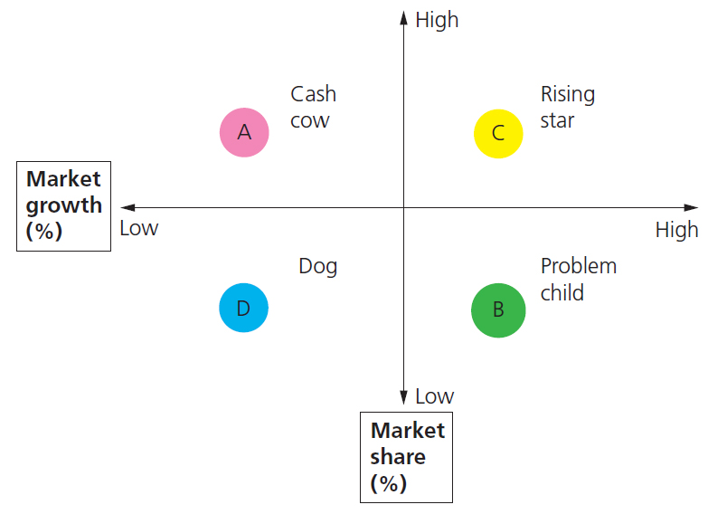
What is an extension strategy?
An extension strategy is an attempt to prolong sales of a product to prevent it from entering its decline stage.
It might be about finding new uses for a product. Play-Doh started life as a wallpaper cleaner in 1930.
It might be about changing the appearance, format or packaging of a product, e.g. Coke bottles becoming plastic with different labels.
It might be about encouraging use of the product on more occasions, such as eating Viennetta for pudding as well as treats and hot days.
It might be about adapting the product, e.g. Apple iPad to iPad Pro

Slide 12
Summary questions
Write down or discuss the answers to these questions.
Name the three parts of the design mix.
Give an example of a way a car could be made more cheaply.
Give an example of how Snapchat differentiates itself from Facebook.
Name the four elements of the product life cycle.
What is the element of the product life cycle called when sales of a product are at their highest?
Give one way a business can extend the life of a product.

