Slide 1
Promotion

Slide 2
Promotion
This section covers the following:
Promotional strategies for different market segments
The use of technology in promotion

Slide 3
Key words
Promotional strategy
A medium- to long-term plan for communicating with your target customers

Slide 4
Promotional strategy – advertising
A strategy is a medium- or long-term plan for meeting business objectives
A promotional strategy is a plan of how the business will communicate with customers to gain sales revenue
Mass market products rely on advertising strategies to inform customers of the name and basic details of the product
Products aimed at a smaller area of the market may use different methods, such as targeting a smaller range of customers using cheaper forms of advertising
Example: GoPro, the sports camera maker, have 10 million followers on Instagram and use customer content to advertise their products
Social media

Slide 5
Key words
Sponsorship
When companies pay to have a brand associated with an iconic individual or event

Slide 6
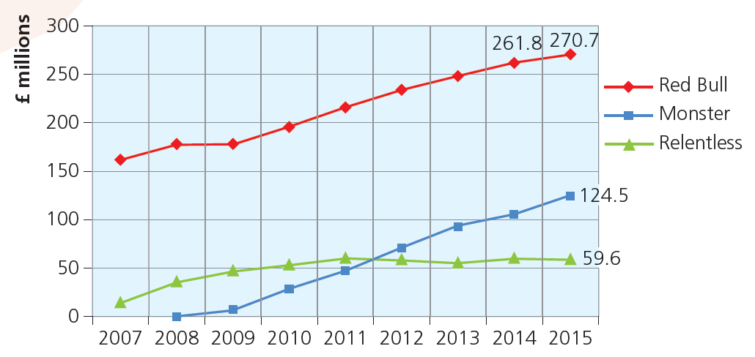
Promotional strategy – sponsorship
Sponsorship is when companies pay to have a brand associated with an iconic individual or event.
Example: Red Bull, the energy drink, wanted to create a well-known brand image that customers related to excitement and risk.
This included paying the costs of a Formula 1 team and Air race championships.
Look at the graph – by how many millions are Red Bull ahead of competitor Monster?
Sponsorship can cost a lot of money so businesses have to be sure of the benefits to sales.
Example: Chevrolet’s sponsorship deal of Manchester United costs £53m per year and will last until 2021.

Slide 7
Key words
Branding
Giving your product or service a name that helps recall and recognition, and gives a sense of personality

Slide 8
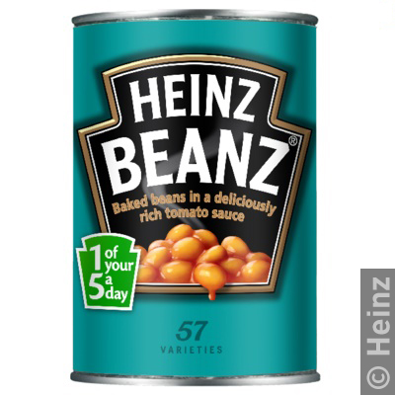
Promotional strategy – branding
Branding is giving your product or service a name that helps recall and recognition, and gives a sense of personality.
Example: the Heinz baked beans started with a logo ‘Beanz Meanz Heinz’ in 1967 and, 50 years later, the brand has its own personality in the minds of consumers.
Creating a brand can be done in a number of ways, including the quality and uniqueness of the product, or customer service or celebrity endorsement.
Benefits of a strong brand include customer loyalty, the ability to charge higher prices without losing demand and the long life of the product.

Slide 9
Promotional strategy – product trials
A product trial means giving potential customers a free taste of a new product.
A product trial can test a small portion of the target market to gain further customer feedback on the product.
This could allow the business to make slight improvements to the product before releasing it to the whole market.
Product trials can also help reduce risks where the business is not confident with the ability of the product to be sold in the larger market.
Free taste

Slide 10
Promotional strategy – special offers
Special offers are normally only used where the business is finding it difficult to sell products to customers, e.g. Buy one get one half price offers.
Special offers can increase sales but may damage the brand if used for a long period.
In some situations special offers may help sales, e.g. January sales or trial sizes of new products.
Special offers

Slide 11
Technology – targeted advertising online
Online adverts are adverts which appear on websites or through the internet, such as the adverts you have to watch before a YouTube clip.
Businesses can keep an accurate record of everything you buy, the websites you visit and even what you talk about on social media websites by using ‘cookies’, a record of your browsing history.
Advertising online is becoming increasingly targeted at customers’ browsing habits. If you spend a long time looking at fashion, adverts will appear offering you the latest styles.
Advertising on line for 2016 is forecast to be over half of all advertising done by businesses.
Forecast

Slide 12
Key words
Viral advertising
When people start to spread your message for you, be it word of mouth or via social media

Slide 13
Technology – viral advertising
Viral advertising is when people start to spread your message for you through social means, be it word of mouth or via social media.
Viral advertising can help businesses cut the costs of advertising. Twitter and Facebook campaigns can be free.
Viral advertising can engage with potential customers in a way advertising by traditional methods cannot achieve, such as instant feedback from customers extremely quickly.
Example: Sportwear brand Underarmour ran a social media campaign starring model Gisele Bundchen.
Women were invited to comment on short messages and video clips which resulted in 5 billion views and comments, with 42% more traffic on the Underarmour website and 28% increase in sales.
The problem is that success is not always guaranteed, with some research suggesting that only 15% of viral advertising works.
Source

Slide 14
Key words
E-newsletters
Regular updates on the activities of a business sent electronically to actual or potential customers

Slide 15
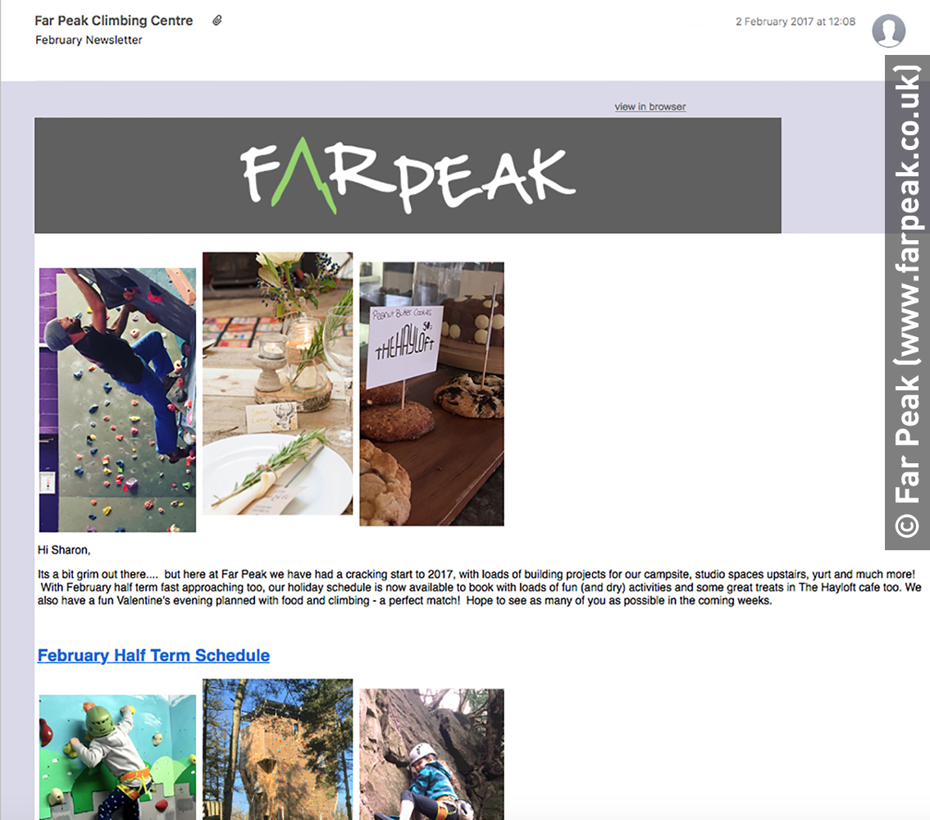
Technology – E-newsletters
E-newsletters are the emails that are sent out to people who have subscribed to a business’s regular product updates.
E-newsletters are normally triggered when a customer is looking at a business websites or buys a product, both of which require an email address.
The benefits of e-newsletters are they are inexpensive and it allows the business to build up a database of potential customers.
However, many of these type of newspapers are unread and fail to create sales.

Slide 16
Summary questions
Write down or discuss the answers to these questions.
What is a promotional strategy?
Give an example of sponsorship.
What is branding?
What is a product trial?
What is targeted online advertising?
What is viral advertising?

