Slide 1
Risk and reward

Slide 2
Risk and reward
This section covers the following:
What is meant by risk
What is meant by reward
The benefits of taking business risks
The drawbacks of taking business risks

Slide 3
Key words
Risk and reward
The balance between the worst that can happen and the best that can happen
Independence
The need of many business owners to make their own decisions and be their own boss
Lack of financial security
Uncertainty for a business owner about day-to-day family income and assets

Slide 4

What is risk and reward?
Risk is about taking a chance, e.g. only 1 in 5 new products are a success.
Products must make enough profit to cover failures.
What were the risks and rewards of founding Facebook for Mark Zuckerberg?

Slide 5
Main risks of staring a business
Identifying a market gap that is big enough to be profitable
Raising enough capital (money)
Getting the right people working the right way
Building a base of customers

Slide 6
Risks in the early days of a business
Making sure customers come back for more (repeat purchase)
Running out of cash, e.g. a hotel with few guests in the winter
Running out of self-belief and motivation when times are tough
Dealing with new customers

Slide 7
Risks of rapid growth
Overtrading – where sales grow faster than the business can cope with
Struggle to cope with rapid increases in staff
Struggle for owner to be a good manager of staff
Complacency – success that leads to the owner making errors

Slide 8
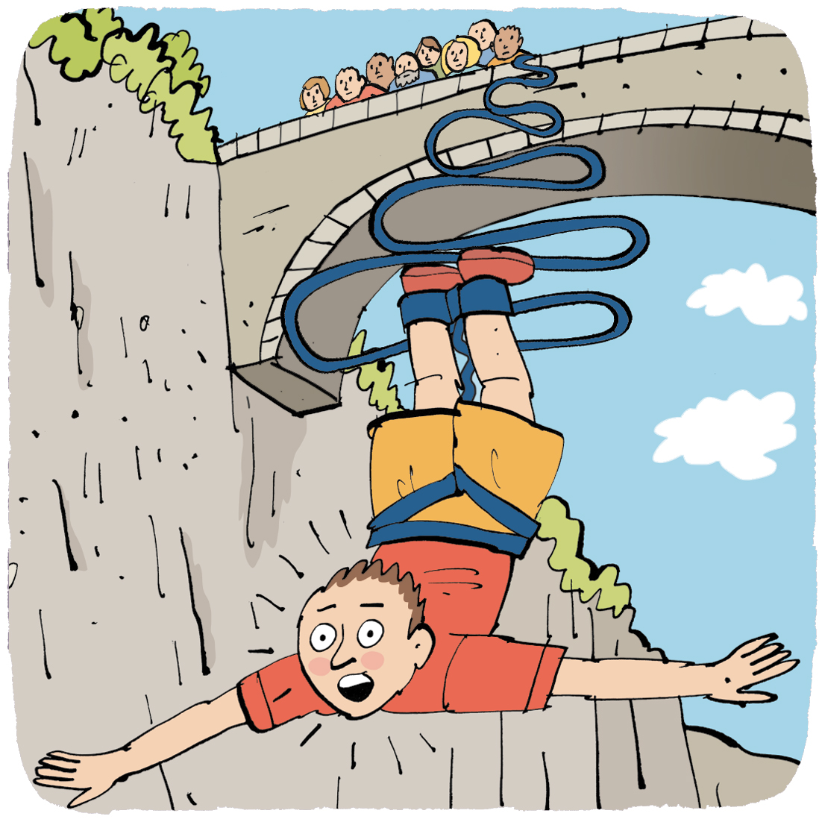
Possible consequences of risks
Business failure – the owner and/or family lose their savings leading family breakdown
Financial loss – unlimited liability where the sole trader has to pay for any debts the business has
Lack of financial security – working for yourself means an income that varies a lot but responsibilities often stay the same, e.g. credit card debts or mortgage

Slide 9
Rewards of starting a new business
Profit and wealth
  e.g. once the business is established it can be sold for a large amount of money
Independence
  e.g. owner can make own decisions, employ others and set standards of care for customers

Slide 10
Striking balance between risk and reward
Businesses need to weigh up the chances of success or failure.
Businesses need to think about the costs of success or failure.

Slide 11
Summary questions
Write down the answers to these questions on lined paper.
Name one risk a new business may face.
Name one reward an owner of a business may benefit from by taking risks.
What are the potential rewards of starting a new business?
What are the risks if a business expands quickly?

