Slide 1
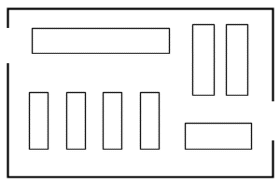
This is your shop floor. Where would you locate your tills and why? Annotate the rest of the diagram with branded and own brand products, explaining why you have done so.

