Slide 1
Business stakeholders

Slide 2
Business stakeholders
This section covers the following:
What a stakeholder is
Stakeholders and their objectives
Small business stakeholders
Whether shareholders are the most important stakeholders
How stakeholders are affected by business activity
How stakeholders can affect business activity
Possible conflict between stakeholder groups

Slide 3
Key words
Stakeholders
All those groups with an interest in the success or failure of a business
Pressure groups
Organisations formed to put forward a particular viewpoint, such as promoting organic farming

Slide 4
What is a stakeholder?
Stakeholders are all those groups with an interest in the success or failure of a business.
Stakeholders may want different things from a business.

Slide 5
Stakeholders
Owners/shareholders
Staff/managers
Customers
Suppliers
Local residents
Local government
Shareholders
Pressure groups such as Friends of the Earth who campaign against businesses that damage the environment, e.g. oil companies.
Can you think of any more?

Slide 6
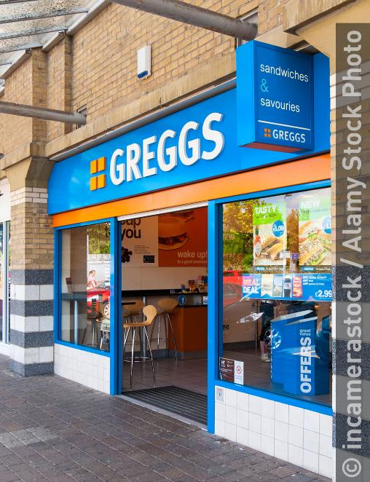
Stakeholders
Different business take different approaches to stakeholders.
Example: Greggs bakeries treat customers and staff as the most important, with shareholders third. Satisfy the first two, and the shareholder objectives are then met!
Shareholders in private companies usually want growth.
Employees want job security and business growth.
Customers want high-quality products, good customer service and innovation.
Pressure groups want honesty and consultation.

Slide 7
Small business stakeholders
Important stakeholders are customers, staff and suppliers.
Relationships need to be close as the small business may ask more than is normally required due to a lack of spare resources.
Example: A small sportswear shop may ask its staff to work longer hours to cover for another member of staff’s sick absence.

Slide 8
Are shareholders the most important?
For large companies called public limited companies, shareholders have the right to vote directors out of office.
This means companies have to be very honest with shareholders as to company priorities or when mistakes are made.
So for these companies the answer is yes – shareholders are the most important stakeholders.
For private limited companies the owner and the family are likely to be the shareholders.
Shareholders are still important, but there may be other more important stakeholders, e.g. a business set up to support the community.

Slide 9
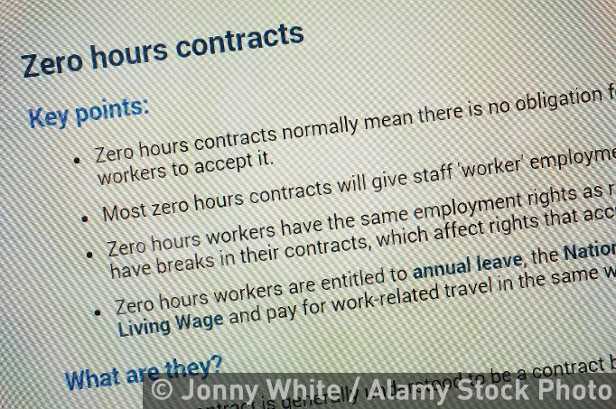
How business activity affects shareholders
About 90% of UK businesses are services such as retail or banking.
Negative effects of business on stakeholders can include low pay, jobs with no guaranteed hours and poor working conditions.
The positives of business on stakeholders include diverse ranges of food and activities, or benefits for working parents such as crèches at work.

Slide 10
How stakeholders affect business activity
Stakeholders can have an impact on businesses, particularly large companies.
Example: Unilever, the owners of the tea brand PG Tips, were forced to stop testing its teas on animals due to local pressure groups.
On other occasions one stakeholder can have a negative impact on many businesses.
Example: The Southern rail train drivers strike in 2017 meant many businesses in London were affected as workers could not get to work.
Stakeholders can have such an effect on big businesses that they often have staff devoted to communicating and consulting with them to avoid problems.

Slide 11
Conflict between stakeholder groups
As different stakeholders have different objectives, particularly in large businesses, there can be conflict between them.
Example: Tesco shareholders will have been pleased that the supermarket decided to reduce the amount it paid to farmers for milk in 2014. This potentially mean more profits for shareholders.
However, the farmer suppliers were not pleased as it meant that some farmers could not make any money from the priced for milk offered by Tesco.
Managing these conflicts and the different needs of stakeholders is important to create a successful business.

Slide 12
Summary questions
Write down or discuss the answers to these questions.
Give an example of a pressure group.
What is a stakeholder in a business?
Why might the government be classed as a stakeholder in a business?
In what type of business are shareholders the most important stakeholders?
Give an example of stakeholders impacting on a business.

