Slide 1
Technology and business

Slide 2
Technology and business
This section covers the following:
The types of technology used in business
How technology influences business activity

Slide 3
Key words
E-commerce
Selling online rather than in a physical one-to-one transaction. An important part of e-commerce is m-commerce, meaning commerce using apps/smartphones rather than websites/PCs.
Social media
Interactive channels of communication, via words, photos or videos, such as blogs, Facebook and Instagram
Digital communication
Messages or conversations conducted via email, text or social media
Payment systems
Ways of paying electronically, such as PayPal

Slide 4
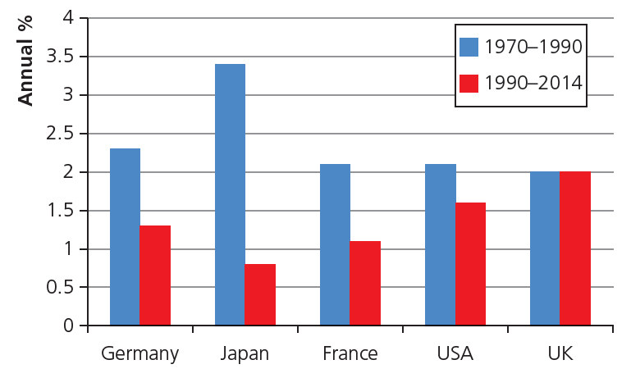
Types of technology used in business
Technology can be any machinery or device developed to help the creation and selling of products.
Technology is associated with doing this faster and more conveniently.
In business terms, this is called productivity.
Productivity is often measured through the growth of a country, known as Gross Domestic Product (GDP).
Is growth in the UK speeding up or slowing down according to the chart?

Slide 5
E-commerce
E-commerce is selling online, rather than in a physical transaction, such as buying pizza via the Domino’s pizza website.
An important part of e-commerce is m-commerce, meaning commerce using apps/smartphones rather than websites/PCs.

Slide 6
Social media
Social media are interactive channels of communication, via words, photos or videos, such as blogs, Facebook and Instagram.
Some businesses treat social media as a way to promote and advertise their products.
Businesses looking to promote products can target customers using social media
Celebrity endorsement of products also has impact. The footballer Ronaldo has a combined 240 million followers on social media, and a product he can be seen wearing can result in sales
Social media allows advertising and promotion to spread virally – not just in the UK, but globally – a big plus for businesses selling products.
Celebrity endorsement

Slide 7
Digital communication
Digital communication is messages or conversations conducted via email, text or social media.
Business can now have a more personalised conversation instantly with potential customers.
Communication can be done anywhere cheap, cutting costs.
The drawback is that the local customer may lose confidence in the communication and feel dissatisfied.
Example: BT did all its call centre work in India as wages were cheap. However, in 2015, due to dissatisfied customers it is now moving digital communication back to the UK.

Slide 8
Payment systems
Payment systems are ways of paying electronically such as PayPal.
There are a number of a payment systems used by businesses including:
Electronic Funds Transfer, where bills can be paid online.
Apple/Android pay, which is a mobile system of paying for goods online or physically simply through a fingerprint on a mobile phone.
The more convenient the system, the more likely the customer is to impulse buy a product.

Slide 9
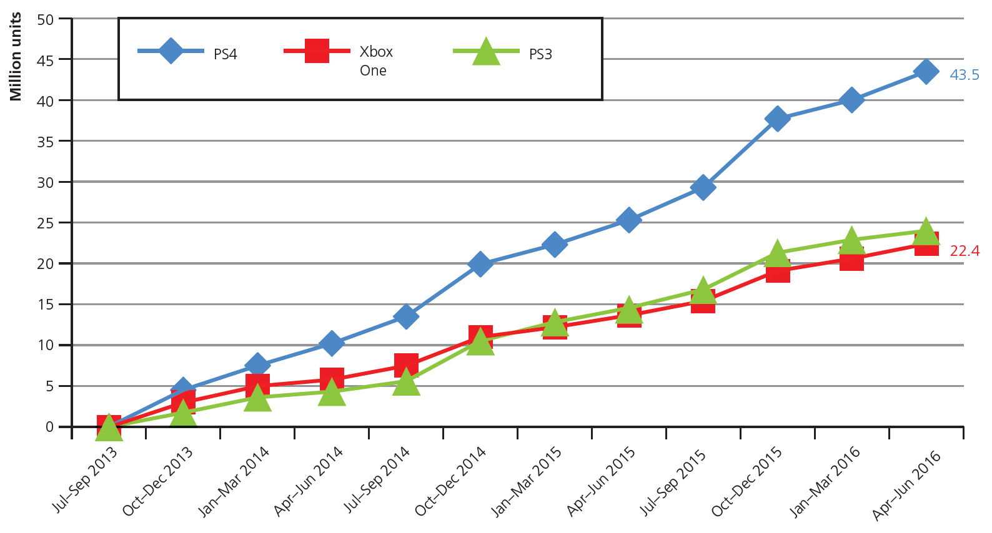
Sales
Certain markets are affected by technology more than others.
Products that have become digital, such as films and games, have been affected massively.
The graph shows sales of console hardware globally.
Which console has sold the most units worldwide?
How may technology have created better sales than the other consoles?
Sony’s games store may have better games, be cheaper to access or have better customer service online.

Slide 10
Costs
A fixed cost is advertising, e.g. TV and newspapers.
Technology allows much more specific targeting of customers through data gathering, e.g. social media likes.
Technology allows more specific targeting of adverts to those likely to purchase products, e.g. look at the adverts around a website compared to that of your mums.
All this means costs can be reduced.
Variable costs include raw material for products.
Online market places make it much easier for businesses to get the best prices for raw materials, thus reducing costs.

Slide 11
Summary questions
Write down or discuss the answers to these questions.
What is e-commerce?
What is m-commerce?
Give one reason why Domino’s might use social media to advertise products.
How might a business be able to reduce costs through the use of digital communication?
Give one way technology can improve sales.
Why might Amazon have launched its first physical shop in London?

