Slide 1
The dynamic nature of business

Slide 2
The dynamic nature of business
This section covers the following:
What a business is
What an entrepreneur is
What is meant by the dynamic nature of a business
The why, how and who about starting business.

Slide 3
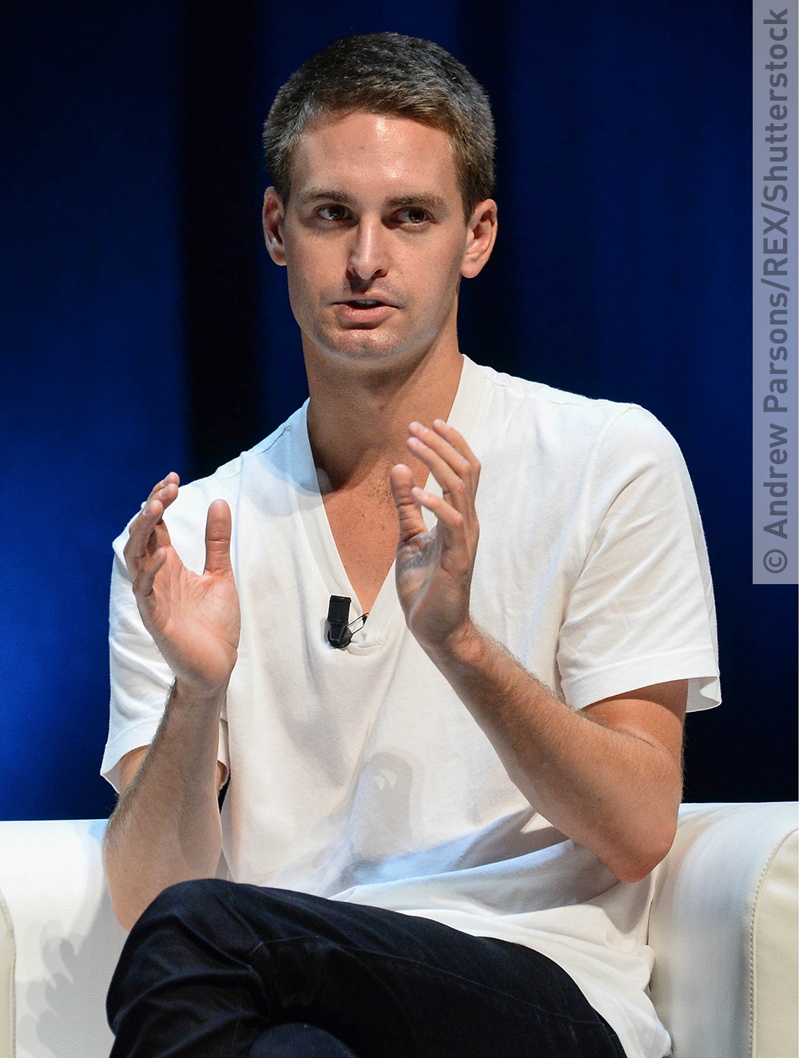
Key words
Business enterprise is about starting something on your own.
The dynamic nature of business is the idea that business is ever-changing because external factors, such as technology, are always changing.
An entrepreneur is someone who shows some initiative by taking a risk in setting up, investing in and running a business.
Venture capital is risk capital provided by an investor willing to take a risk in return for a share in any later profits; the venture capital provider will take a share stake in the business.
Evan Spiegel first presented his idea for Snapchat to his classmates in 2011

Slide 4
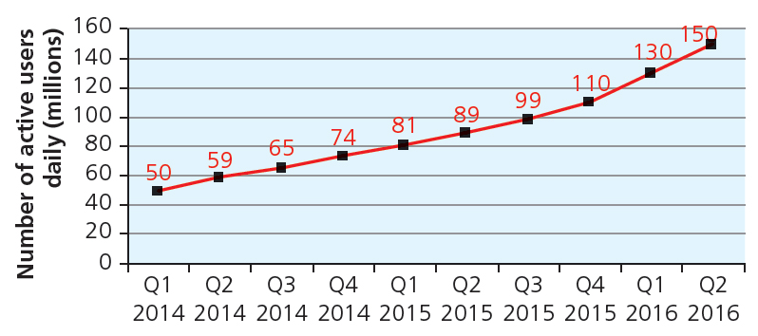
Dynamic nature of business
Businesses includes charities, individuals or sports clubs – e.g. Manchester United or Apple computers.
Wants and needs of customers change all the time.
Technology means businesses have to adapt quickly.
Example = Snapchat
Successful businesses are
those that adapt the
quickest.
Starting a business
comes down to the
WHY, the WHO and
HOW are key to success. Please complete worksheet.
Snapchat growth

Slide 5
Why a person starts a business
Can you guess the following blank words?
A person might want to be their own boss.
They might want to make their own decisions independently.
They might want to make money.
Can you think of any other entrepreneurs and why they started their business?
What might put someone off from starting a business?
oss
ndependently
oney

Slide 6
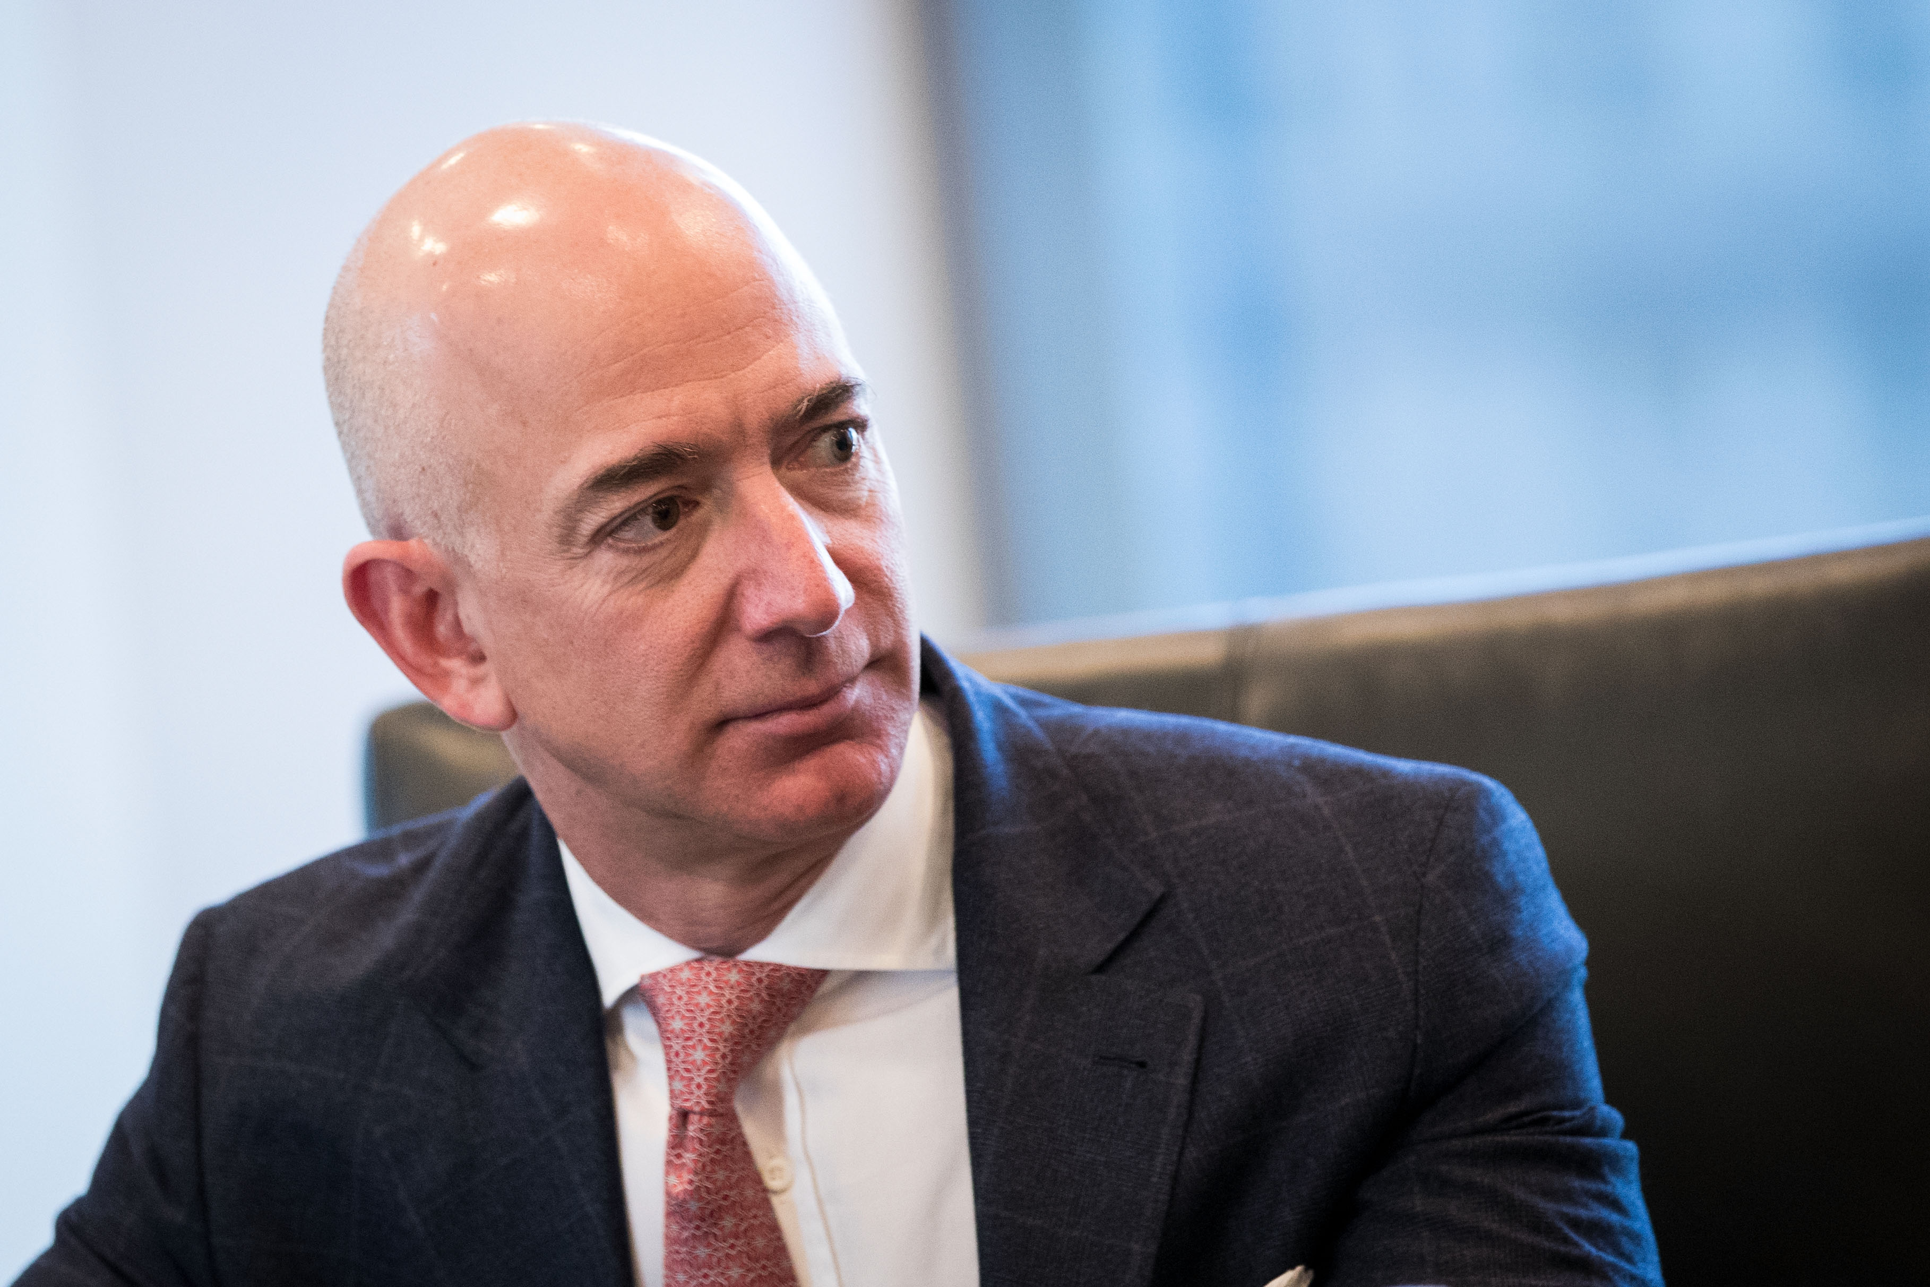
Qualities and skills to start a business
Qualities
Resilience (ability to bounce back from setbacks)
Enthusiasm
Hard working
Willingness to take risks
Skills
Listener as well as speaker
Well organised
Good at planning
Persuasion (ability to convince others to buy or do something)
Good at managing others
Jeff Bezos is the founder of Amazon. What qualities might he have?
Resources
Looking for help and advice, e.g. financial
Specialist knowledge and skills, e.g. website design

Slide 7
Qualities and skills to start a business
Which qualities and skills do the following famous and successful people have?
Simon Cowell
Richard Branson
Lady Gaga
Taylor Swift

Slide 8
Starting a new business
How does a person starts a new business?
From home
Part time
Full time
As a social enterprise
  A type of non-profit business that employs people and earns income in order to help address perceived social or environmental issues.

Slide 9
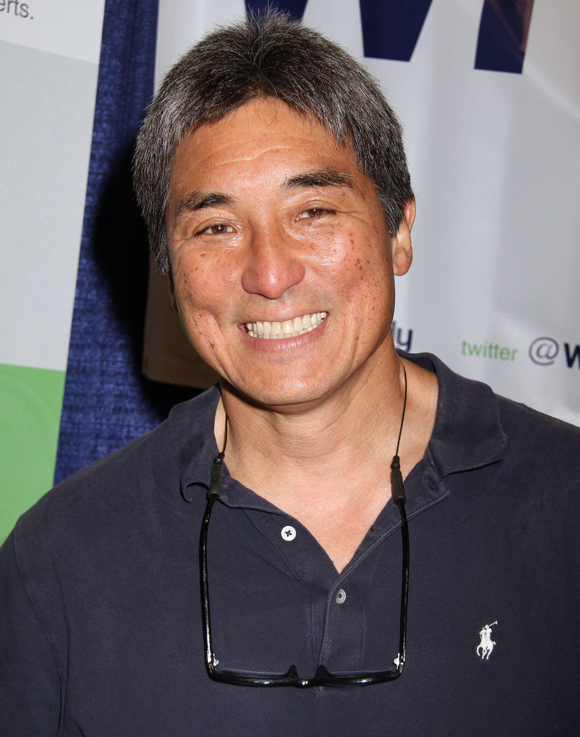
Money to start a business
Write a business plan.
  A written statement of what is hoped to be
  achieved, how it will be achieved and what
  money needs investing to make a profit
Raise capital.
  Money that needs to be invested to trial the
  business idea
Capital can come from banks or own funds.
Capital can come from a venture capitalist.
  An investor who is willing to take a risk in providing money to a business fir a share of the business and/or profits
Guy Kawasaki is a venture capitalist and marketing specialist.

Slide 10
Summary questions
Write down the answers to these questions on a piece of lined paper.
What is a business?
What is an entrepreneur?
What is meant by the dynamic nature of a business?
Give a reason why a person might start a business.
Give a quality and a skill required to start a business.
Give a way of starting a business.

