Slide 1
The economy and business
This section covers the following:
The economic climate and its impact on businesses
Unemployment
Changing levels of consumer income
Inflation
Changes in interest rates
Government taxation
Changes in exchange rates

Slide 2
Key words (1)
Economic climate
Like the weather, the economy can run cold or hot. The economic climate is a measurement of the current economic outlook, which might be promising or worrying.
Consumer incomes
The amount households have available to spend after income taxes have been deducted
Exchange rate
The value of one currency measured by how much it will buy of other currencies

Slide 3
Key words (2)
Inflation
The rate of increase in the average price level
Interest rate
The annual cost of a loan to the borrower
Taxation
Charges places by government on goods, imported goods and the incomes of individuals and companies
Unemployment
When someone of working age wants a job but cannot get one

Slide 4
Impact of economic climate on business
As the economy changes regularly, businesses are affected in many ways.
Economic climate is a measurement of the current economic situation, which might be promising or worrying.
Like the weather, the economy can run cold or hot.
We look at six factors in detail and the way businesses can be affected by each of these factors.
The factors are unemployment, changing levels of consumer income, inflation, changes in interest rates, government taxation and changes in exchange rates.

Slide 5
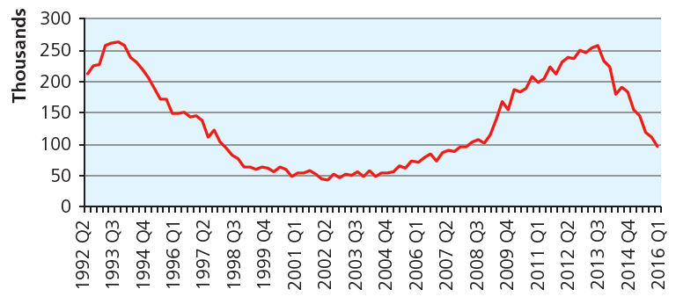
Unemployment
Unemployment is when someone of working age wants a job but cannot get one.
Unemployment tends to be at its worst when an economy is in recession.
Look at the graph. When did unemployment start to reduce after 2009?
Businesses that deal in essential goods will find unemployment in the
economy has little effect. People still need loo rolls!
Businesses that deal in luxury goods will be affected by unemployment.
The latest TV set will have to wait.

Slide 6
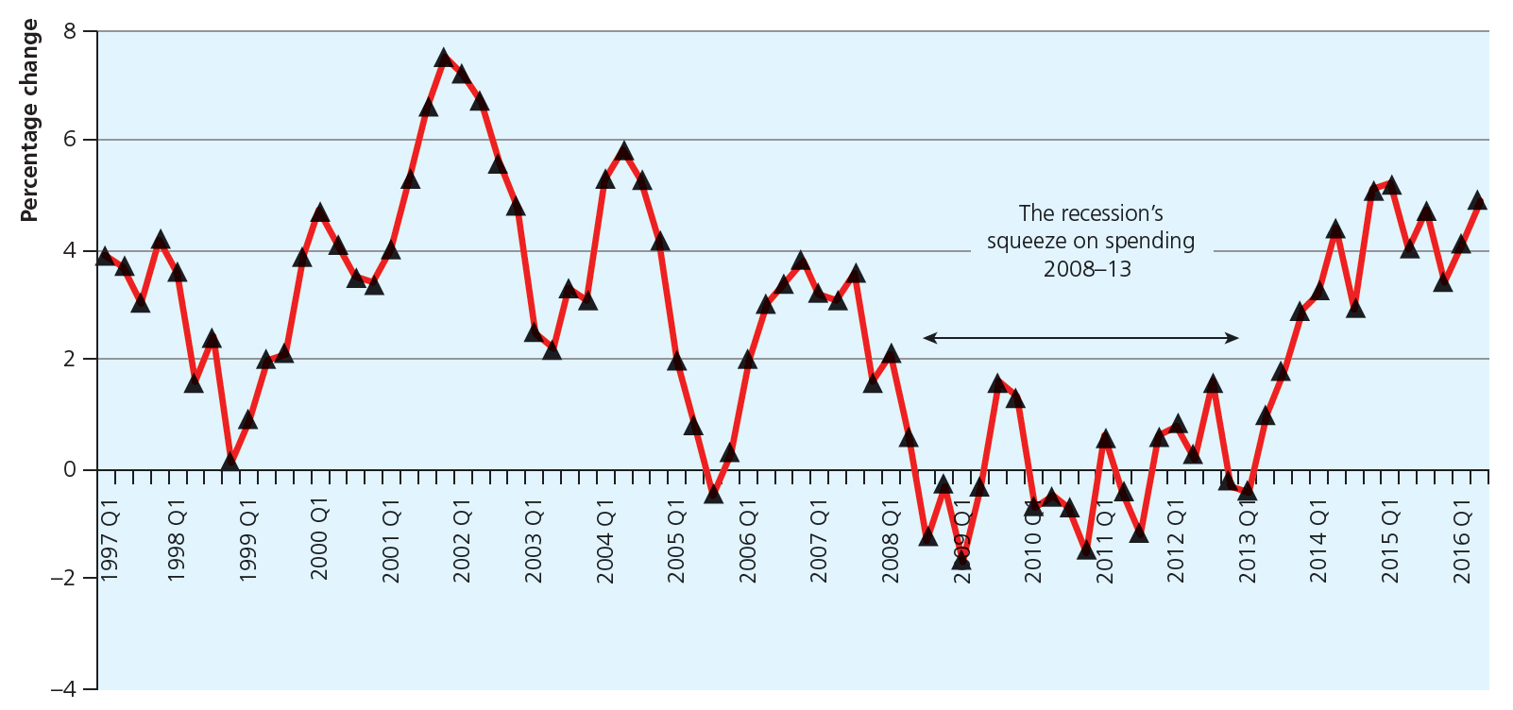
Changing level of consumer income
Consumer income is the amount households have available to spend after income taxes have been deducted.
The graph shows changes in spending by consumers.
As the economy grows consumers tend to feel more confident and spend more on luxury goods such as jewellery
When the economy goes into recession consumer spending reduces
Some businesses have increased consumer spending even in times of overall reduction. UK cinema sales reached an all-time high of £1bn in 2009.

Slide 7
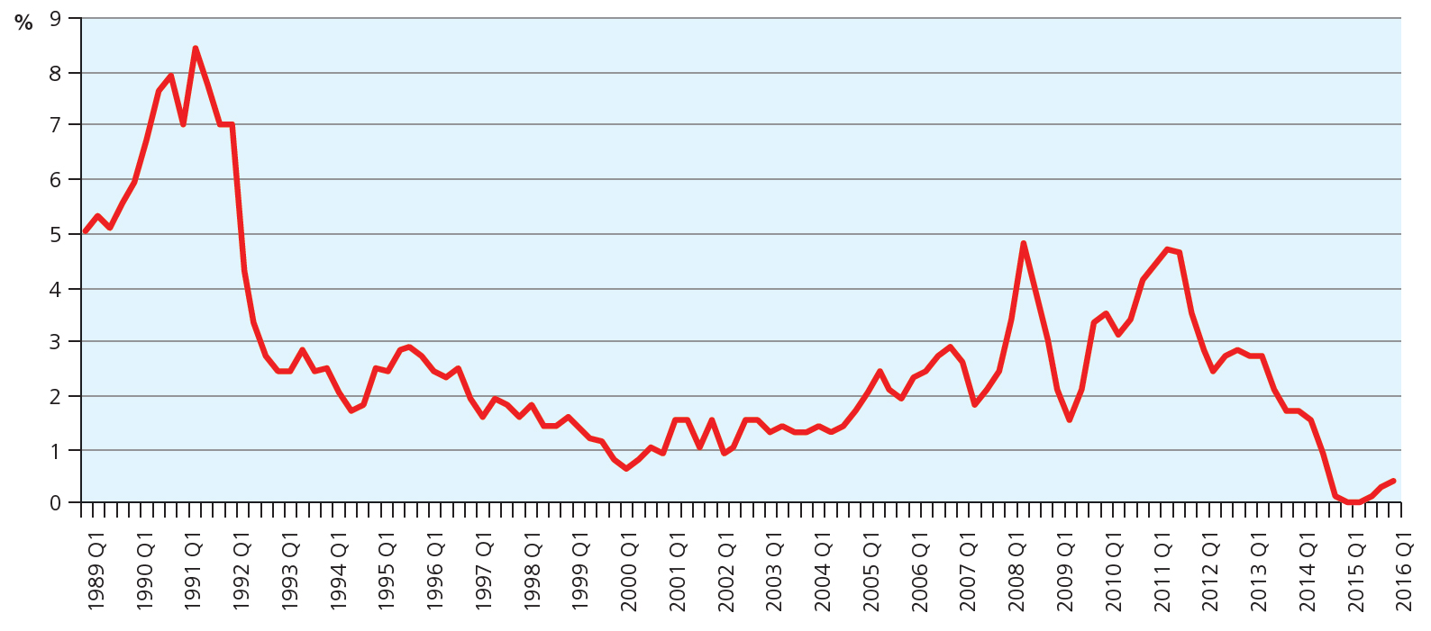
What is inflation?
Inflation is the rate of increase in the average price level.
The rate of inflation is the percentage change in prices compared with a year ago.
Look at the graph showing UK inflation.
Inflation below 2% means costs for businesses are easily managed.
When is this on the chart?
Inflation of 4% or more puts businesses under pressure as their costs are rising.
When was the last time on the chart that inflation was 4% or more?

Slide 8
Changes in interest rates
Interest rates are the annual cost of a loan to the borrower.
The higher the rate, the less businesses and consumers tend to borrow
Lower rates mean consumers spend more on luxuries such as holidays, which results in more profit and more jobs
Lower rates also mean lower costs of borrowing on finance, such as overdrafts
Higher rates mean consumers have more expensive borrowing, such as mortgages for houses, and less spending
Businesses have the same problem and higher fixed costs mean profits reduce.

Slide 9
What is government taxation?
Taxes are charges places by the government on goods, imported goods and the incomes of individuals and companies.
Corporation tax is a tax on company profits. In 2016 it was 20%.
The higher the tax rate, the less companies have to invest in future growth.
Businesses importing products from abroad may also have to pay tax, which makes products more expensive and more difficult to sell, such as steel from China for car production.
Consumers are taxed on their income and have to pay a tax on goods and services purchased, called VAT.
Rises in consumer taxes reduces income, which reduces the ability to spend on some goods and services, particularly luxury goods.

Slide 10
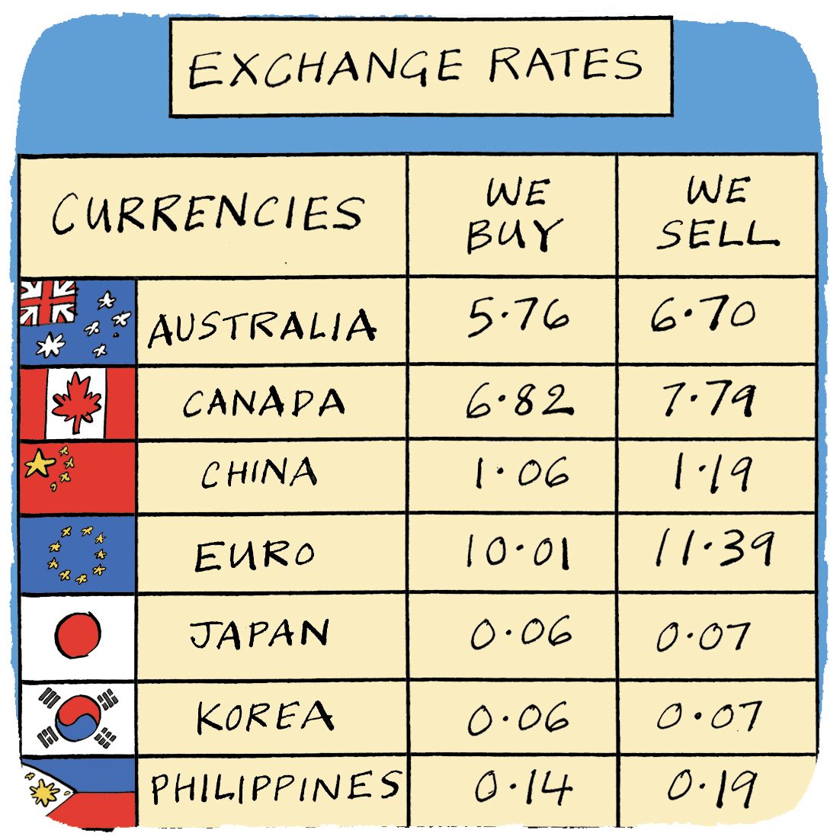
Why does a strong pound matter?
Exchange rates shows the value of one currency measured by how much it will buy other currencies.
A strong pound means lots of dollars to the pound.
Goods imported into the UK will be cheaper for consumers. An iPad might cost £300 instead of the price a month ago of £400.
For businesses exporting to the US, a strong pound means their products will appear more expensive to US consumers, e.g. a Dyson vacuum goes up to $500 compared to $400 the month before.
If a strong pound continues, exporters cannot sell products abroad and business in the UK cannot compete with cheap imports, leading to potential staff cuts.

Slide 11
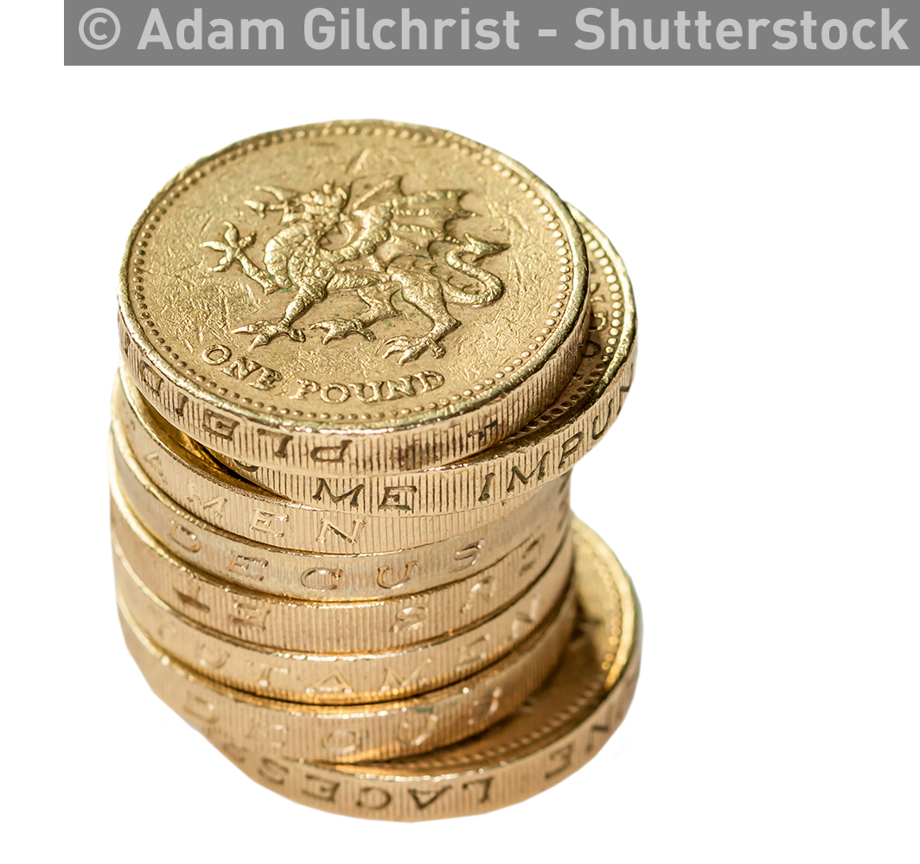
What if the pound is weak?
This means that £1 buys less foreign currency, e.g. £1 today buys $1.20 compared to £1 a month ago which bought $1.50.
Businesses selling products in the UK can now compete better with imported products from say the US.
Businesses exporting from the UK can now also compete better as their products are cheaper in places like the US.
However, businesses that import raw materials will find their costs have increased due to a weak pound.
This means their finished products will be more expensive and could offset the benefits of a weaker pound.

Slide 12
Exchange rate calculations rules
Rule 1: when exchanging pounds to a foreign currency…
multiply.
Example
A Dyson vacuum costs £199.
The exchange rate is $1.20 per £1.
£199 multiplied by $1.20 = ?
$238.80
Rule 2: when exchanging from a foreign currency to pounds…
divide.
Example
A MacBook Pro costs $1499.
The exchange rate is $1.20 per £1.
$1499 divided by $1.20 = ?
£1,249.17

Slide 13
Summary questions
Write down or discuss the answers to these questions.
A pair of Levi jeans costs $43. Work out the price of a pair of jeans in the UK if the exchange rate is £1 to $1.30?
Which type of business is unlikely to be negatively affected by an increase in unemployment?
What happens to business investments when interest rates rise?
Give one reason why a rise in inflation could negatively affect a business.
Does a reduction in tax on consumers help businesses? Explain why.

