Slide 1
The role of business enterprise

Slide 2
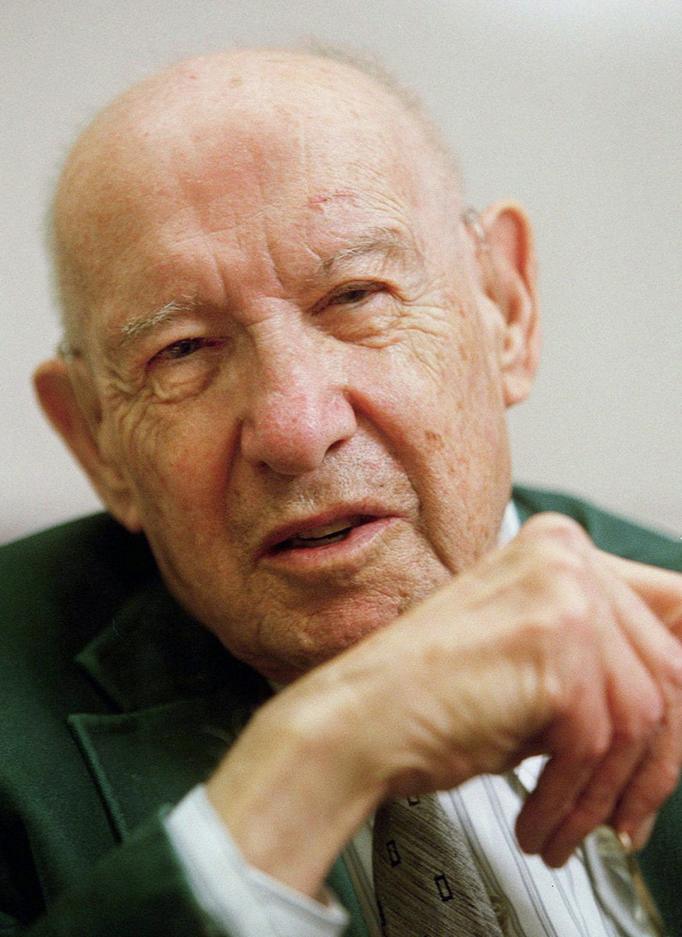
The role of business enterprise
This section covers the following:
What is the purpose of business?
What are goods or services?
Meeting customer needs
Peter Drucker said the role of business was to create and keep a customer

Slide 3
Key words
Goods
Products that may be fresh, such as apples, or manufactured, such as Heinz Baked Beans
Services
Providing useful ways to help people live their lives, such as shops, restaurants and hospitals
Customer needs
The products or services people need to make life comfortable
Customer wants
The products or services people need to make life comfortable

Slide 4
What are goods or services?
Goods are products that can be touched and held.
Products must be manufactured, possibly in a factory, e.g. iPhones.
Services usually cannot be touched or held, they are invisible.
Services include health care, sports and leisure.
Services in the UK make up almost 80% of business conducted.
In China products are more important.
A comparison of products and services in the UK and China (Source: CIA World Factbook 2016)

Slide 5
Management skills for producing goods
Design of packaging or logos
Selling the right range of products
Persuading shops to sell products
Making sure orders are delivered to customers on time

Slide 6
Meeting customer needs and wants
Meeting needs of customers means products or services are likely to sell.
e.g. customers need transport to work so rail services are in demand.
Meeting wants means persuading customers to buy a product or service that is not needed, but wished for.
e.g. buying a large screen mobile phone
Meeting wants requires money spent on advertising and customer service.

Slide 7
How businesses meet customer wants
Employ staff based on their ability to form close relationships with customers.
Invest heavily in research and development to create new products and technologies.

Slide 8
Summary questions
Write down on lined paper the answers to these questions.
What is a good?
What is meant by a service?
Name one difference between a good and a service.
Give an example of a product/service a consumer needs.
Give an example of a product/service that a business has to encourage consumers to want.

