Slide 1
The role of entrepreneurship

Slide 2
The role of entrepreneurship
This section covers the following:
Taking risks
Making business decisions
Showing leadership
Organising resources

Slide 3
Key words
Human resources
A term used by organisations that simply means employees
Leadership
Using qualities such as decisiveness, initiative and self-belief to make a business successful
Risk taking
Making decisions where unknown factors or chances of failure loom large in the decision-makers mind
Business decisions
Choices that must be made, usually within a short time
Resources
Things or people that can be used to help build and run a business

Slide 4
Seven main causes of start-up failure
Discuss with the person next to you – What stands out and why?

Slide 5
What is risk taking?
Entrepreneurs often want to create an organisation or product that can make a difference.
Bold ideas can lead to large financial and emotional rewards.
Example: Dragon’s Den entrepreneurs invest money and time but only get one chance to convince the wealthy dragons that their idea is worth the investment.

Slide 6
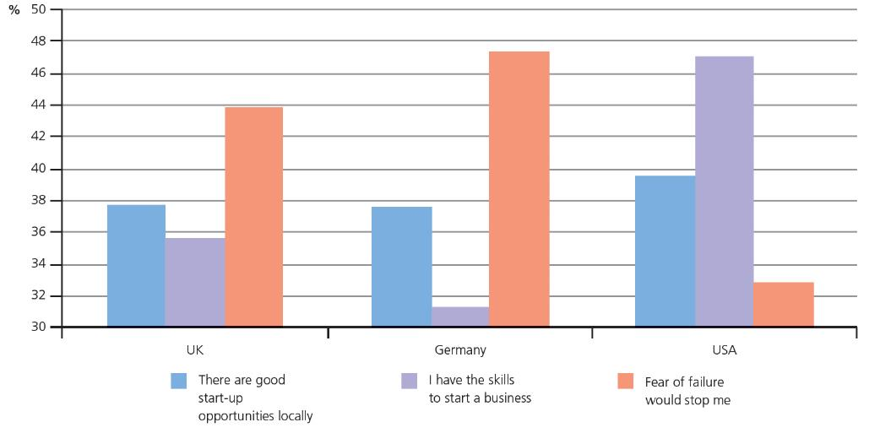
Taking risks vs. business success
Confidence and attitudes to taking risks are key to success.
The bar chart shows the attitudes of entrepreneurs in different countries.
The UK is more entrepreneurial than Germany.
However, the USA shows much better confidence in their entrepreneurial skills than the UK.
More confidence in taking risks ultimately translates into more successful businesses.

Slide 7
What is a good business decision?
Good decisions make a business successful.
The key to making a good decision is to gain as much information about the issues before making it.
Sources of information include customers, staff, suppliers, and competitors.
Why is this information so important?
Small businesses need to make decisions quickly.
Even if the decision is wrong it can still be changed before the competition realises.

Slide 8
Making successful business decisions
Large businesses are often slow at making decisions, which leads to more risks.
Decisions need to be made at the right time to be successful.
Example: Dillons bookshop was taken over by Waterstones and it was found that over half the shops were losing money.
If Dillons had used this information earlier it could have led to a more successful business.

Slide 9
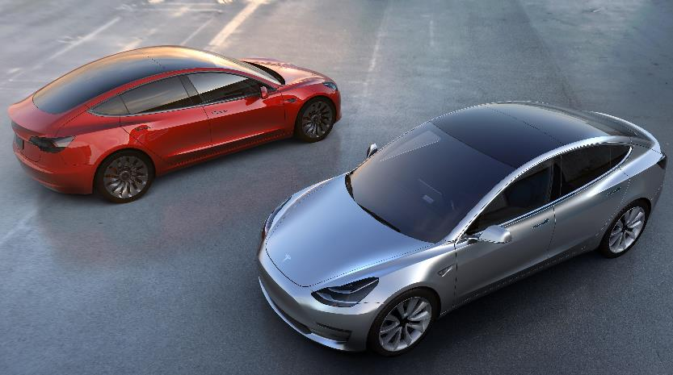
Showing leadership
Good leadership often leads to successful decisions and well managed risks.
Example: Elon Musk has convinced many people to invest in his start up electric car business, Tesla.
He has shown a high level of charisma and self-belief in a product few felt would be successful.
Tesla’s £25,000 model 3 cars have seen 373,000 pre-orders (May 2017) largely as a result Musk’s leadership and vision.

Slide 10
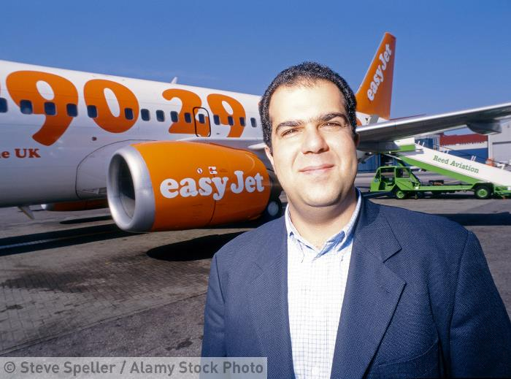
Organising resources
Human resources – the right people with the skills needed to deliver the business product
Physical resources such as premises, decoration, chairs
Daily resources, for example the right food for a restaurant
Resources are often managed by the entrepreneur when starting the business.
As the business grows this then must be delegated.
Stelios Haji-Ionnou of EasyJet hired a manager to run the business
Take 2 minutes with the person next to you to discuss what potential problems could occur if you don't manage these resources appropriately?

Slide 11
Summary questions
Give an example of a well-known entrepreneur who takes risks.

Slide 12
Summary questions
Give a reason why the entrepreneur has been successful.

Slide 13
Summary questions
Name a leadership skill that has helped the entrepreneur be successful.

Slide 14
Summary questions
Give an example of a resource a business has to manage.

Slide 15
Summary questions
What are human resources?

Slide 16
Summary questions
A business might fail due to poor l______?

Slide 17
Summary questions
Give another reason why a business might fail.

Slide 18
Summary questions
What is value added?

Slide 19
Summary questions
Give 3 ways in which a business can add value?

Slide 20
Summary questions
What is the difference between products and services?

