Slide 1
The sales process

Slide 2
The sales process
This section covers the following:
What the sales process is
Product knowledge
Speed and efficiency of service
Customer engagement
Responses to customer feedback

Slide 3
Key words
Customer engagement
The attempt to make a customer feel part of something rather than an outsider
Customer feedback
Comments, praise or criticisms given to the company by its customers
Post-sales service
Service received after the purchase is completed, perhaps because something has gone wrong or as a way of promoting customer engagement
Product knowledge
How well staff know all the features of the products and the service issues surrounding the products

Slide 4
What is the sales process?
The sales process is how the business engages with customer to get them to purchase their product or service.
This means effective customer service which needs to be:
clear as to what customers value the most
practical and cost effective
a genuine wish to help
offered at the right place and time.

Slide 5
What is product knowledge?
Product knowledge is how well staff know all the features of the products and the service issues surrounding the products
Good training needs to be given to ensure strong product knowledge. For example, M&S food staff are given trials of new products offered to help inform customers
Loyal staff that stay with the business mean they gain a huge knowledge of the business and its products. ALDI pay staff above the minimum wage to help retention
Staff committed to customers helps with product knowledge. Staff at the furniture retailer Sofology are not paid on commission to ensure they are focused on the sofa that meets the customers’ needs.

Slide 6
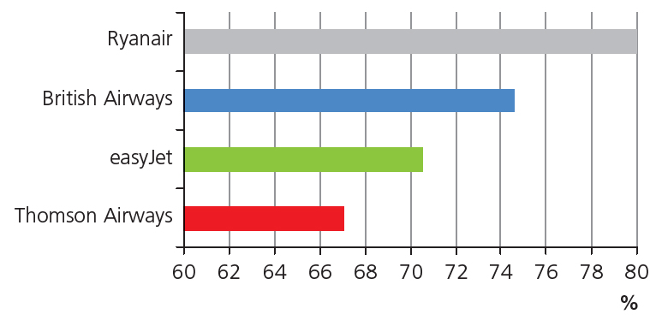
Speed and efficiency of service
Good customer service is designed to ensure customers feel valued.
Efficiency of service means the product is delivered to the customer when they want it, in good condition and problems are sorted out as soon as possible.
Customers are willing to pay for good customer service if it is value for money.
Example: First class tickets on 2016 Airline of the year Etihad include a A$20,000 3 room apartment on board.
Compare this to Ryanair, which offers minimum seat space and everything, including luggage, is an extra.
Look at the bar chart. Who would you choose if you wanted a flight to be on time?

Slide 7
Customer engagement
Customer engagement is the attempt to make a customer feel part of something.
Customer engagement can be done through word of mouth, newsletters or personal invitations to special events.
It can also be done through loyalty cards. The M&S Sparks card allows customers to tailor make their own discounts and gain invitations to exclusive launches of products.
The internet and social media are increasingly playing a role in engaging customers. Go Pro, the sports camera maker, encourages customers to post their videos on Instagram, which has doubled the output from the website since its launch in 2014.
Example: Milkshake chain Shakeway has encouraged customers to post pictures and messages on Twitter, allowing the business to create a family who share in the success of the product.

Slide 8
Responses to customer feedback
Customer feedback can be comments, praise or criticisms given to the company by its customers.
This can be by word of mouth, letter, phone call and increasingly through website reviews or a business’s Twitter account.
The worst businesses see feedback as a problem. Scottish Power, the energy company, came last in terms of customer service in a 2015 survey.
The best businesses see feedback as a chance to improve. Amazon were the best customer service business in 2015, with customers very happy with their no-quibble returns policy and customer review system.
TalkTalk, the telecoms provider, has been responding to customer complaints about raising prices on fixed yearly contracts. Adverts in 2017 now guarantee this won’t happen – post-sales service is important to keep customers.
Best customer service

Slide 9
Summary questions
Write down or discuss the answers to these questions.
What is the sales process?
Give an example of how a business can ensure staff have good product knowledge.
Who is good customer service aimed at?
Name one benefit of good customer service to a jewellers.
How are Ryan Air more efficient than British Airways?
What is a benefit to the business of good customer engagement?

