Slide 1
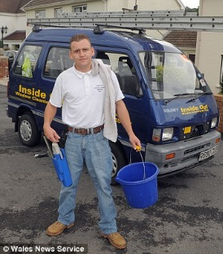
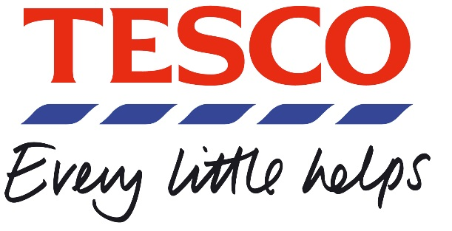
Usually has little capital for expansion and is heavily reliant on the owner’s personal commitment to make the business a success. Because of its unincorporated status, if the business is unsuccessful, there is no protection from limited liability because the finances of the business are inseparable from those of the owner. They are commonly found in the provision of local services e.g. newsagents, plumbers and hairdressers. | Can keep its affairs reasonably private and thus the owners can determine their own objectives without the pressure to achieve short-term profit Funded by shares that cannot be sold without the agreement of the other shareholders, meaning they cannot be traded on the Stock Exchange Share capital can be less than £50,000 Tend to be limited in size Must have LTD after its name | Shares traded on the Stock Exchange, meaning finance can be raised more easily Control of the business can be lost Subject to scrutiny by the financial press Could be led to focus on short-term profits for shareholders Must produce public accounts
A business owned by one person. The owner may operate on his or her own or may employ other people. | A small-to medium-sized business that is usually run by the family or the small group of individuals who own it. | A business with limited liability, share capital of over £50,000, at least 2 shareholders, 2 directors, a qualified company secretary and, usually, a wide spread of shareholders. It has PLC after the company name.

