Slide 1
Understanding Business Performance

Slide 2
Understanding Business Performance
This section covers the following:
Understanding business performance
Information from graphs and charts
Financial data
Marketing data
Market data
The use and limitations of financial information

Slide 3
Key words
Bar chart
Data presented so that the height of the bar represents the quantity involved; good for making comparisons
Line graph
Data presented as lines, making it easy to identify trends, especially if time is on the horizontal axis
Pie chart
Data presented in a circle, with each slice of the pie representing a proportion of the whole; good for proportions of a total, e.g. market share

Slide 4
Why understand business performance?
Quantitative data regarding how a business is performing helps businesses to analyse, inform and justify decisions.
For example, data can used to compare sales with that of competitors or see if more outlets require opening due to increased demand for products.
Data can be expressed in a number of ways to help analysis, e.g. bar charts or line graphs.

Slide 5
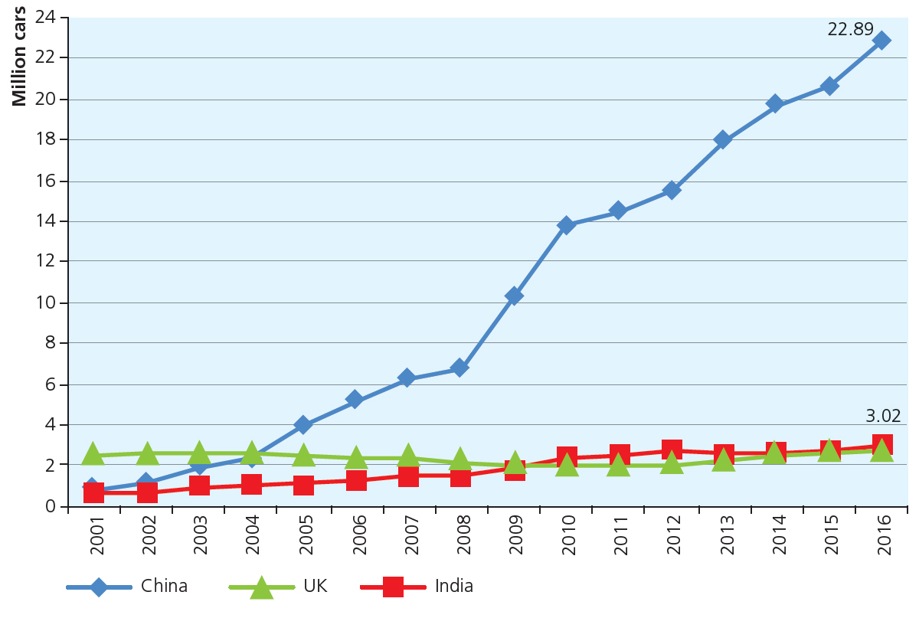
Line graphs
A line graph is data presented as lines, making it easy to identify trends, especially if time is on the horizontal axis.
See the graph showing car sales for India, China and the UK.
Which country would you decide to sell cars in if you are in charge of Jaguar Land Rover?
By looking at the growth in sales between 2001 and 2010 Jaguar Land Rover were able to predict China as the market to enter.
In 2010 the business entered the market and sold 25,000 cars in the first year.

Slide 6
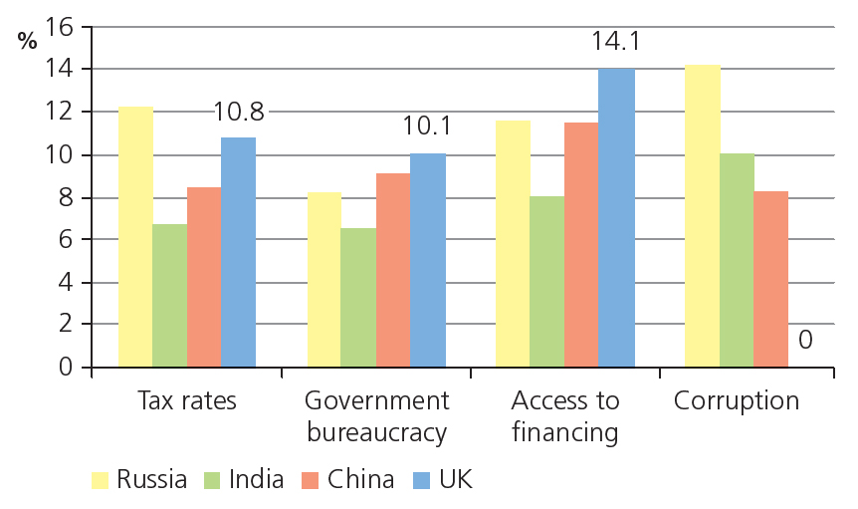
Bar charts
A bar chart is data presented so that the height of the bar represents the quantity involved.
Bar charts are good for making comparisons.
Look at the chart comparing problems for businesses in four countries.
What is the biggest problem for businesses in China and India?

Slide 7
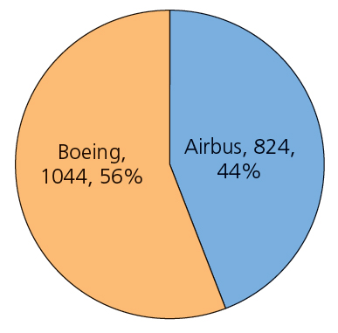
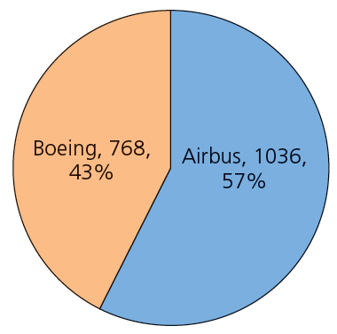
Pie charts
A pie chart is data presented in a circle, with each slice of the pie representing a proportion of the whole.
Pie charts are good for proportions of a total, for example market share.
Look at the pie charts comparing orders for passenger planes in 2006 and 2015.
Which business has improved their share of the market from 2006?
What Boeing needs to work out is how to regain the competitive advantage, possibly by making even larger planes that are more fuel efficient.

Slide 8
Advantages and disadvantages
Look at the table of advantages and disadvantages of the three types of charts.
Which chart would be the best one to use for showing trends of data over a period of time?
 | Line graphs | Bar charts | Pie charts
Advantages | Good for data shown over many time periods … and for looking at how one factor affects another, e.g. sales in pounds and money spent on advertising | Good for data shown over two or three time periods Good for comparing the size of several different items, e.g. populations of the ten biggest countries | Good for showing proportions, e.g. Cadbury’s share of the UK chocolate market Size of the circle can be made proportional to the quantity it represents
Disadvantages | Too many lines can be confusing, so it can only be used to compare two or three series of data A risk of oversimplifying in assuming that an upward line will stay upward in the future | Cannot easily be used to compare data over many time periods If there’s too much data it get confusing to the eye | Pies show big differences clearly, but for small differences a bar chart can be clearer Cannot show trends over a number of years

Slide 9
Looking at financial data
Gross and net profit margins and average rate of return can help businesses make decisions.
Looking at the actual or expected profit or loss from the business or a specific deal helps make decisions.
Working out the breakeven point for a product or business, e.g. whether more advertising needs to be done to create more sales.
Forecasting cash flow to look at whether expansion can be funded from retained profits or will need some form of short or long term finance.

Slide 10
What is marketing data?
Marketing data includes the business’s own sales figures and spend on marketing as well as primary market research.
As launching products can be very expensive, the business needs to be able to look at the risks of success and failure.
Primary market research will help the business see if the product is likely to be wanted by potential customers.

Slide 11
What is market data?
 | UK |  | China
 | Total sales (£ millions) | £ per person | £ per person
2009 | 572.7 | 9.23 | 1.29
2010 | 593.0 | 9.49 | 1.56
2011 | 614.3 | 9.75 | 1.95
2012 | 638.3 | 10.05 | 2.28
2013 | 644.6 | 10.09 | 2.64
2014 | 643.9 | 10.01 | 3.09
2015 | 642.9 | 9.64 | 3.41
Market data includes secondary market research.
Businesses can collect market data from government statistics, Euromonitor or Mintel, though they may have to pay for it.
Look at the table on sales of disposable nappies in the UK and China.
Why is the spend on disposable nappies per person increasing in China?
If you were in charge of the £50m budget for advertising Pampers nappies, where might you spend a large amount of money?

Slide 12
The use of financial information
The business performance can be analysed by:
Current trends in market share, e.g. Samsung’s market share in smartphones was double Apple’s in July 2016. What can be done to improve?
Current trend in profits, e.g. Apple’s profits have fallen in 2016 for the first time in 15 years.
Current trends in cash flows, e.g. Apple’s cash inflow of $16.1bn in 2016 was a record.

Slide 13
The limitations of financial information
Data is only as good as the person interpreting it. Businesses can often be overly optimistic.
Calculations can be misinterpreted, leading to poor decision making.
Raw figures may be unreliable or biased
Talking to staff may give details into business situations that data cannot reveal.
Data is not always the best predictor of good business decisions.

Slide 14
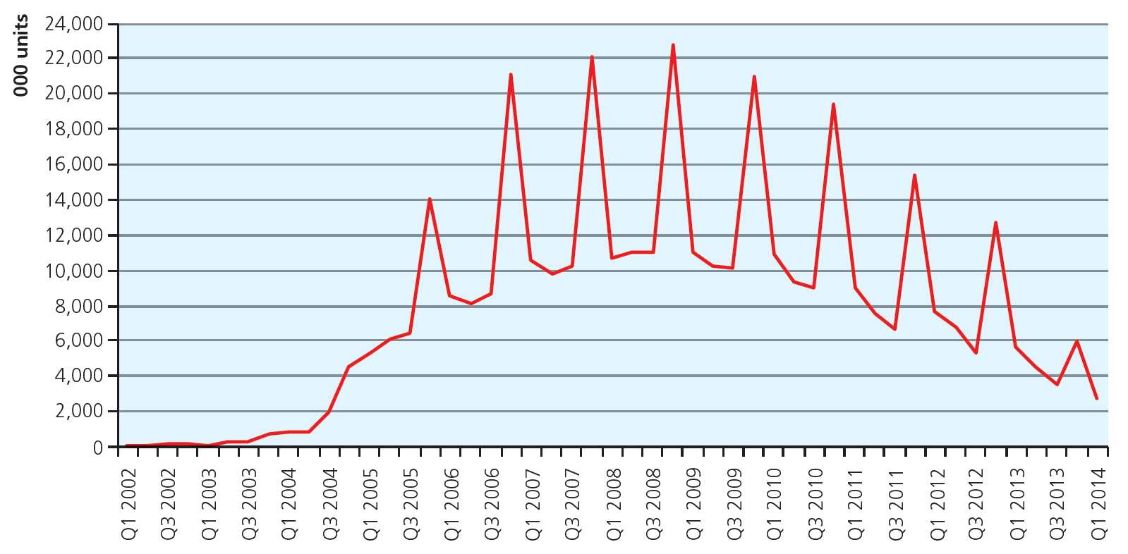
The limitations of financial information
Example: See the graph below for iPod sales. Sales only started to rise significantly after the launch of iTunes in 2004.

Slide 15
Summary questions
Write down or discuss the answers to these questions.
What is a benefit of a bar chart?
Which type of chart helps measure trends?
What is a disadvantage of a pie chart?
What is an example of financial data?
Why might market data be useful to helping a business prioritise its advertising budget?
Name one limitation of using financial information.

