Slide 1
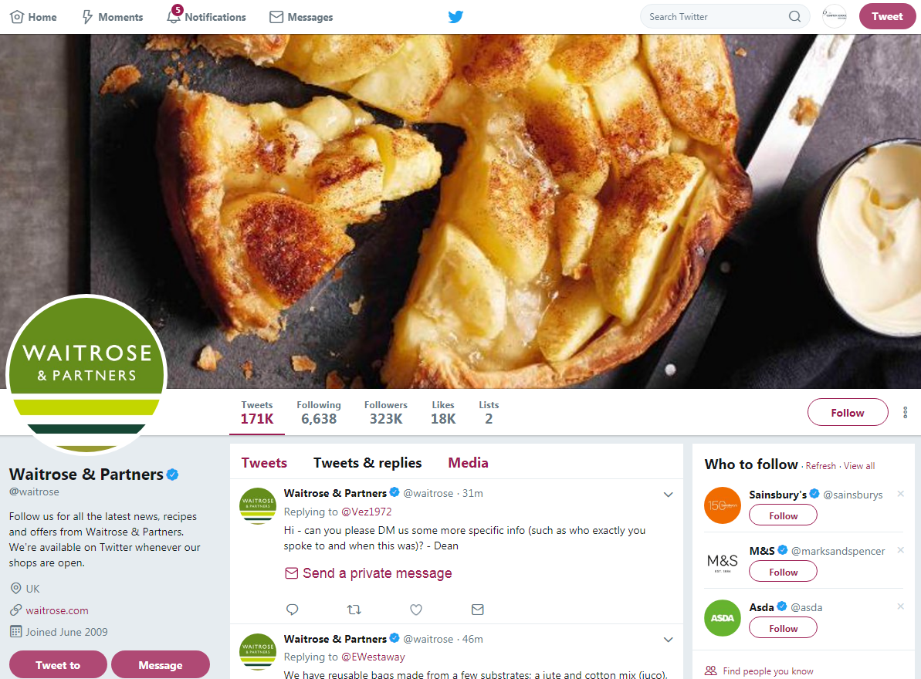
Customer complaint posted on the Waitrose Twitter page regarding a number of empty shelves around their local store and its poor, overall appearance.
You will need to read the complaint on Twitter and prepare an appropriate written response.
I recently visited the North Finchley branch of Waitrose and was annoyed to find lots off shelves empty, and the store looked very untidy and was shabby in appearance
You have 280 characters remaining:

Slide 2
Phone Call received by Waitrose from a disgruntled customer complaining about how poorly they were treated by a member of staff when they visited their local store recently. They had asked for some help finding a specific product for a young child allergic to dairy and received very little help.
You will need to prepare a role-play script as to how you think the conversation might go and how you would respond to this customer complaint over the phone. Be prepared that the customer might add in an unexpected question.

Slide 3
Face to Face conversation between an unhappy customer and a member of staff at the Customer Service Desk at a local Waitrose store concerning a faulty electrical toaster.
You will need to prepare a role-play script as to how you think the confrontation might go between you and the complaining customer. Be prepared that the customer might add in an unexpected question.

