Slide 1
Working with suppliers

Slide 2
Working with suppliers
This section covers the following:
What procurement is
Building relationships with suppliers
The impact of logistics and supply decisions

Slide 3
Key words
Procurement
Obtaining the right supplies from the right supplier

Slide 4
What is procurement?
Procurement is obtaining the right supplies from the right supplier.
Procurement is important to the success of a business as customers will expect products to be available when they want them.
Suppliers must be chosen that deliver goods on time, to the right quality and at the right price.
It is all about building strong relationships.

Slide 5
Key words
Availability
Knowing how to get the right supplies quickly – just when you need them
Trust
Building a business relationship in which both sides know that the other won’t let them down

Slide 6
Building relationships with suppliers
Quality needs to be high in order to produce low priced goods as faulty items cost more money to replace.
Delivery, where the supplies need to be brought to the business on time, is all about reliability.
Availability means a supplier is needed who can cope with small orders to very large orders at different times. Deliveries may need to be flexible.
Cost means finding the cheaper supplier giving the business lower variable costs and higher profit margins. For large businesses they can buy in bulk so will be able to drive costs down, whereas a small business may not have such buying power.
Trust covers areas such as obtaining credit, where the supplier allows payment up to 60 days after delivery. Small businesses may not get credit easily so this can dictate the supplier.

Slide 7
Key words
Logistics
Ensuring that the right supplies will be ordered and delivered on time

Slide 8
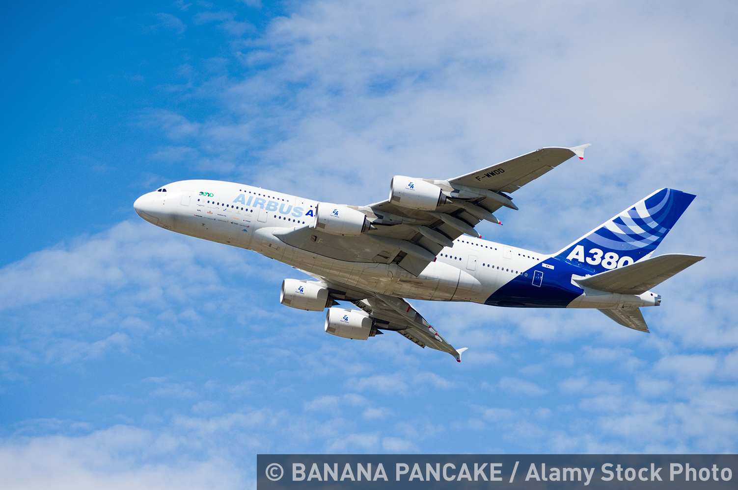
Logistics
Logistics means ensuring the right supplies will be ordered and delivered on time. Well managed logistics means:
better reputation for the business
lower costs of production, as the product can be completed quicker and sold quicker
high customer satisfaction, as the product is the right quality, the right price and delivered at the right time.
Example:
In 2016 Airbus, the plane maker, had 20
planes that could not be completed as
their US engines were not ready.
An estimated 1bn euros was delayed
being paid to Airbus as the planes could
not be sold until finished.

Slide 9
Summary questions
Write down or discuss the answers to these questions.
What is procurement?
Out of the five ways of building a relationship with suppliers, which one do you think is the most important? Explain.
Why is it easier for Tesco to dictate supplier costs than a small corner shop?
What is meant by logistics?
Give one impact of well managed logistics.
Give one risk associated with poorly managed logistics.

